Slide 1



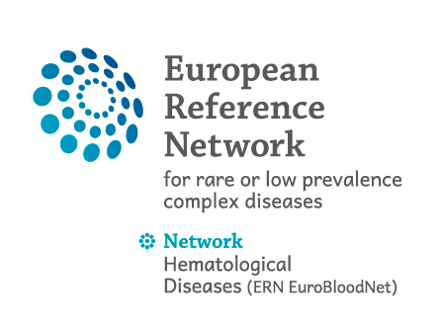

Somatic mutations in acquired aplastic anaemia
Austin G Kulasekararaj
Consultant Haematologist and Honorary Senior Clinical Lecturer
King’s College Hospital/King’s College London, UK

Slide 2
Disclosures
Research support (to institution) | Celgene/BMS and Novartis
Consultant | Samsung, Novonordisk
Speaker’s fees | Alexion/AstraZeneca, Akari, Apellis, Celgene/BMS, Novartis, Ra Pharma/UCB, Roche, SOBI
Scientific advisory board | Alexion/Astra Zeneca, Apellis, Amgen, Biocryst, Celgene/BMS, Novartis, Regeneron, Roche, SOBI, Janssen

Slide 3
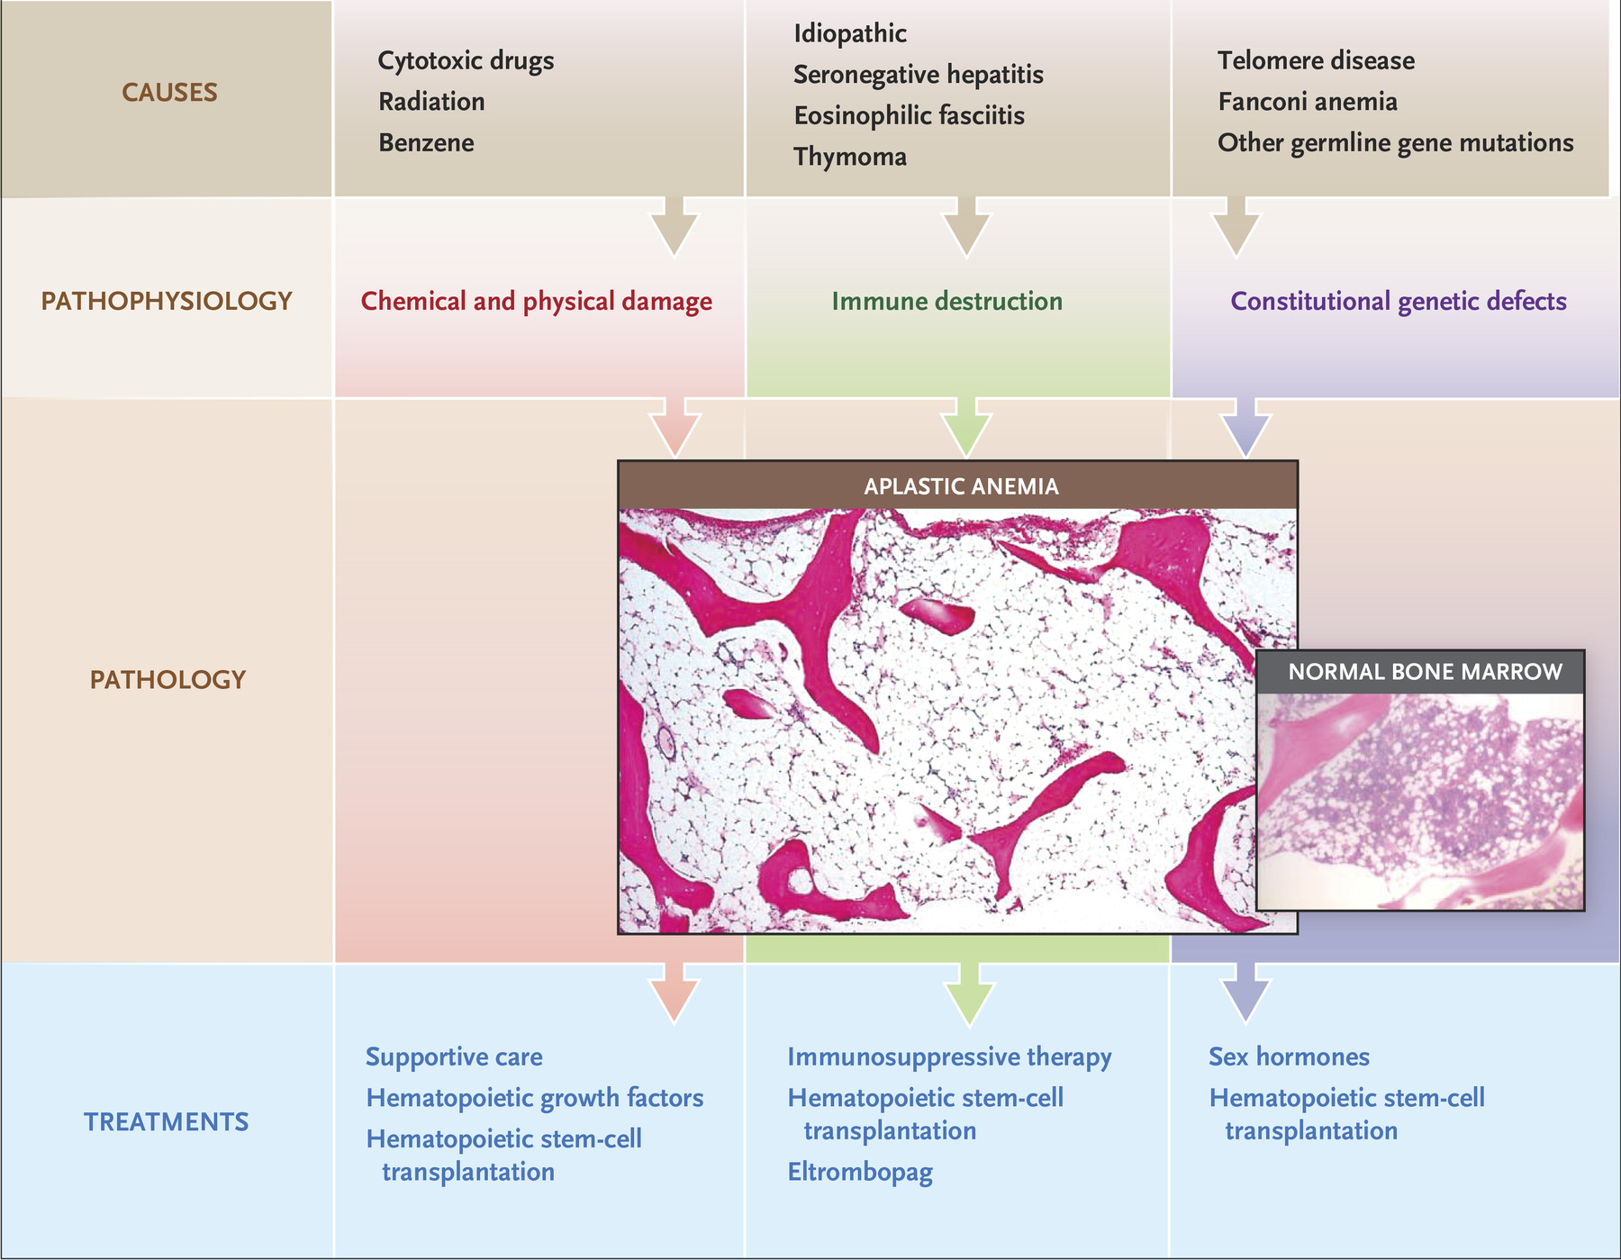
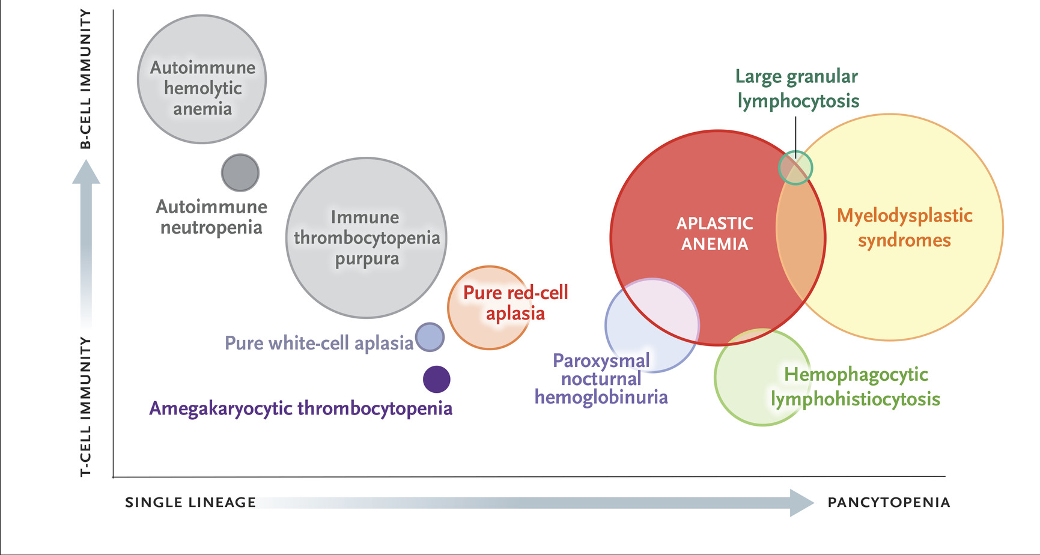
Aplastic Anaemia

Slide 4
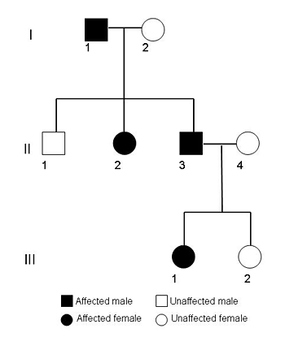
How we investigate a new AA patient @ King’s
Bone marrow
Asp + biopsy
Cytogenetics/FISH
SNPA karyotyping
Myeloid gene panel
History, clinical exam.
Blood
FBC & film
Reticulocyte count
LFTs, Hep B,C,HIV
ANA
Immunoglobulins
T, B and NK subsets
Confirm diagnosis
Determine disease severity
Tissue bank: blood, BM, skin
Radiology
CT chest (fibrosis)
US abdomen
PNH, T-LGL
Look for abnormal clones
Exclude constitutional AA
DEB test,
Telomere length
Constitutional gene
panels
Red cell ADA levels
ADA2 levels
HLA tissue typing
HLA antibody screen if poor increments
Check platelet count increment
MDT review
Cardiac
ECG and ECHO

Slide 5
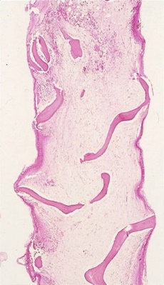
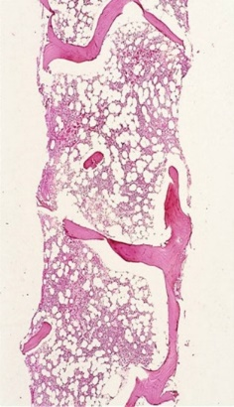
Relationship between Aplastic Anaemia and PNH
AA/PNH syndrome
PNH
AA
Hypocellular
bone marrow
40-50%
Normocellular+
bone marrow
10%
Cytopenias
Haemolysis
PNH clone size
Sub-clinical PNH ......……....... Haemolytic PNH

Slide 6
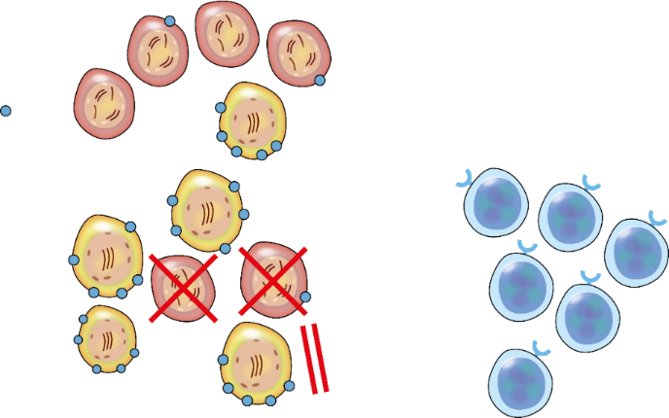
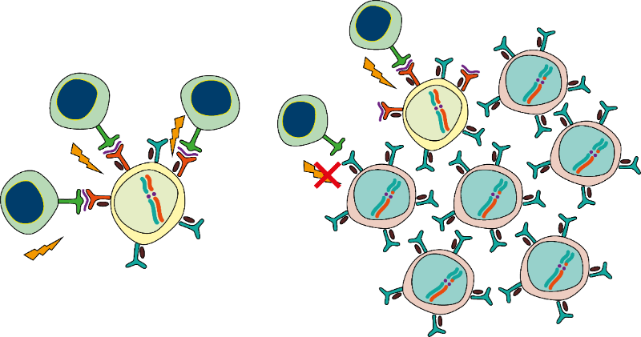
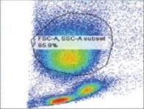
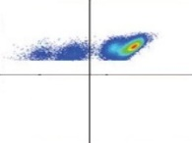
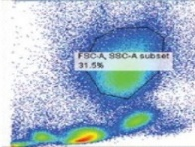
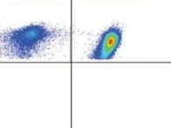




Cytogenetic clones in AA that evade immune attack
Trisomy 8¹
Copy number neutral 6p loss of heterozygosity²
Del 13q³
HSC
CTL
8+
CD8+ T cell
clonal expansion
UPN 3
del(13q) FISH (Peripheral blood) 32.2%
UPN 7
del(13q) FISH (Peripheral blood) 4.0%
WT1
Changes in the proportion of del(13q) cells after IST in 8 patients
LOH
100
CTL
CTL
SSC-A
ch6
SSC-A
CD11b
CTL
ch6
CD11b
80
Cytokines
1000
10 ⁴
TCR
1000
10 ⁴
800
10 ³
TCR
800
10 ³
LOH
ch6
60
600
10 ²
TCR
HSPC
600
LOH
10 ²
LOH
→
c-myc
Survivin
CDK1
400
CTL
400
Del(13q) cells (%)
10 ¹
ch6
ch6
10 ¹
ch6
→
40
200
HLA*
200
→
0
0
200
400
600
800
1000
10 ⁰
10 ⁰
10 ¹
10 ²
10 ³
10 ⁴
0
0
200
400
600
800
1000
10 ⁰
10 ⁰
10 ¹
10 ²
10 ³
10 ⁴
A*02:01
A*02:06
A*31:01
B*40:02
Recombination of 6p arms
LOH
FSC-A
CD55, CD59
LOH
20
FSC-A
CD55, CD59
HLA
ch6
ch6
0
del(13q) FISH 0%
del(13q) FISH 12%
del(13q) FISH 0%
del(13q) FISH 12%
0
5
10
15
20
25
30
35
40
45
50
Months from diagnosis
GPI-AP, glycosylphosphatidylinositol-anchored protein; FISH, fluorescent in situ hybridization; UPN, unique patient number
Ch6, chromosome 6; CTL, cytotoxic T lymphocytes; HLA, human leukocyte antigen; HSC, hematopoietic stem cell; HSPC, hematopoietic stem/progenitor cell; LOH, loss of heterozygosity; TCR, T cell receptor; WT1, Wilms tumor protein
Sloand EM et al. Blood 2005;106:841–851; 2. Katagiri T et al. Blood 2011;118:6601–6609 3..Hosakawa K et al. Haematologica 2012;97:1845–1849
Notes:
And contribute to haemopoiesis

Slide 7
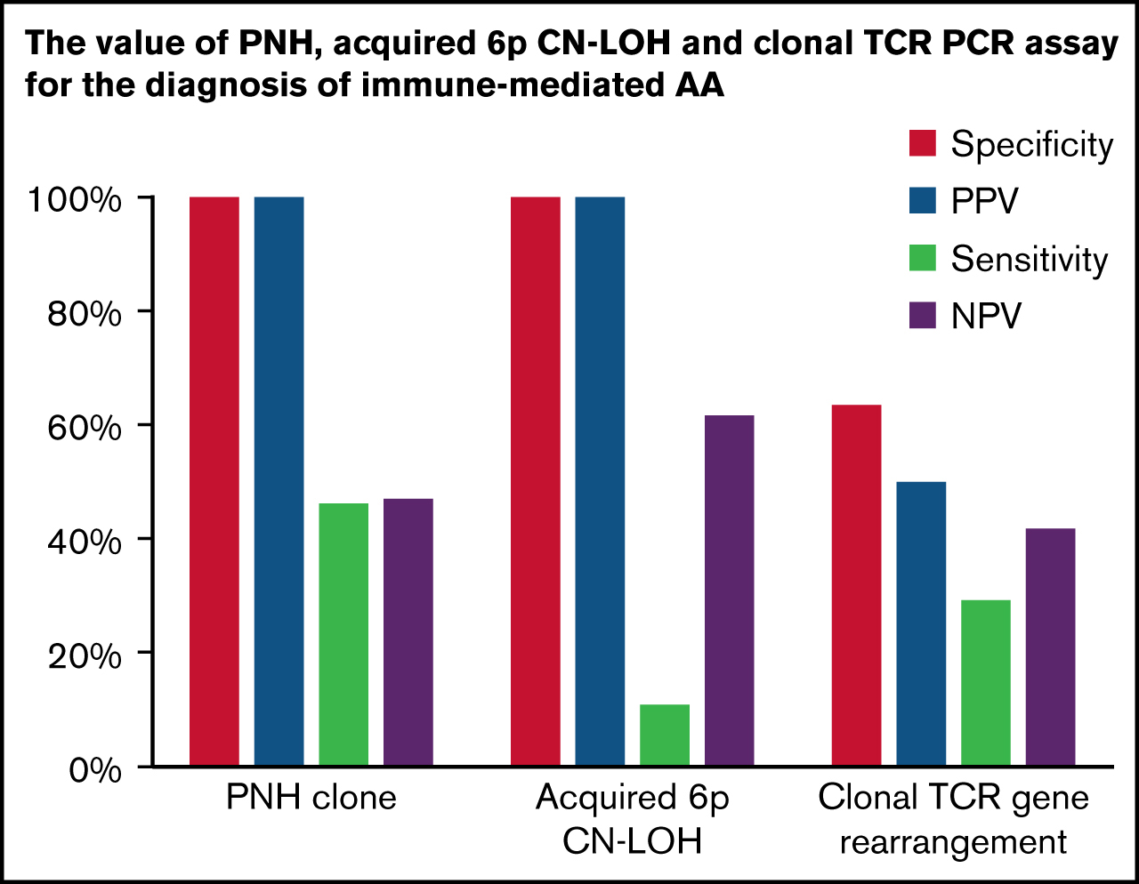
PNH clones, 6p CN-LOH, and clonal TCR gene rearrangement
Shah et al, Blood Adv, 2021
Notes:
Figure Legend:
Comparison of the prevalence of 3 AA-associated laboratory findings (6p CN-LOH, PNH clones, and clonal TRG rearrangement) in AA and PNH patients. (A) The prevalence of 3 AA-associated laboratory findings (PNH clones, acquired 6p CN-LOH<sup>MHC</sup>, and clonal TRG rearrangement) in the 72 AA patients within the CHOP-Penn cohort who had all 3 tests performed. The bar graph on the left depicts a combined prevalence of 64% for PNH clones, acquired 6p CN-LOH<sup>MHC</sup>, and clonal TRG rearrangement, with the frequency and co-occurrence of each finding shown in the Venn diagram on the right. (B) A paired bar plot presenting the prevalence of the indicated laboratory findings in patients with AA and PNH disease. PNH patients were defined as those with clinical hemolysis and >30% PNH granulocytes on flow cytometry, and, by definition, all PNH disease patients had PNH clones. In contrast to AA patients, who had 11% prevalence of 6p CN-LOH, none of the 39 PNH disease patients had detectable 6p CN-LOH clones (OR 10.39; P = .025) at the level of sensitivity of the SNP-A assay (∽5% clone size). Conversely, among 13 AA patients who had acquired 6p CN-LOH, PNH clones were found in 4 patients (31%), ranging from 0.01% to 1.30% granulocyte clone size. Compared with AA (29%, 26 of 89 patients), PNH disease patients had a higher prevalence of clonal TRG rearrangement (60%, 12 of 20 patients; OR 3.63; P = .018); this trend endured following age adjustment, although it was no longer statistically significant (common OR 3.07; P<sub>adj</sub> = .068).

Slide 8
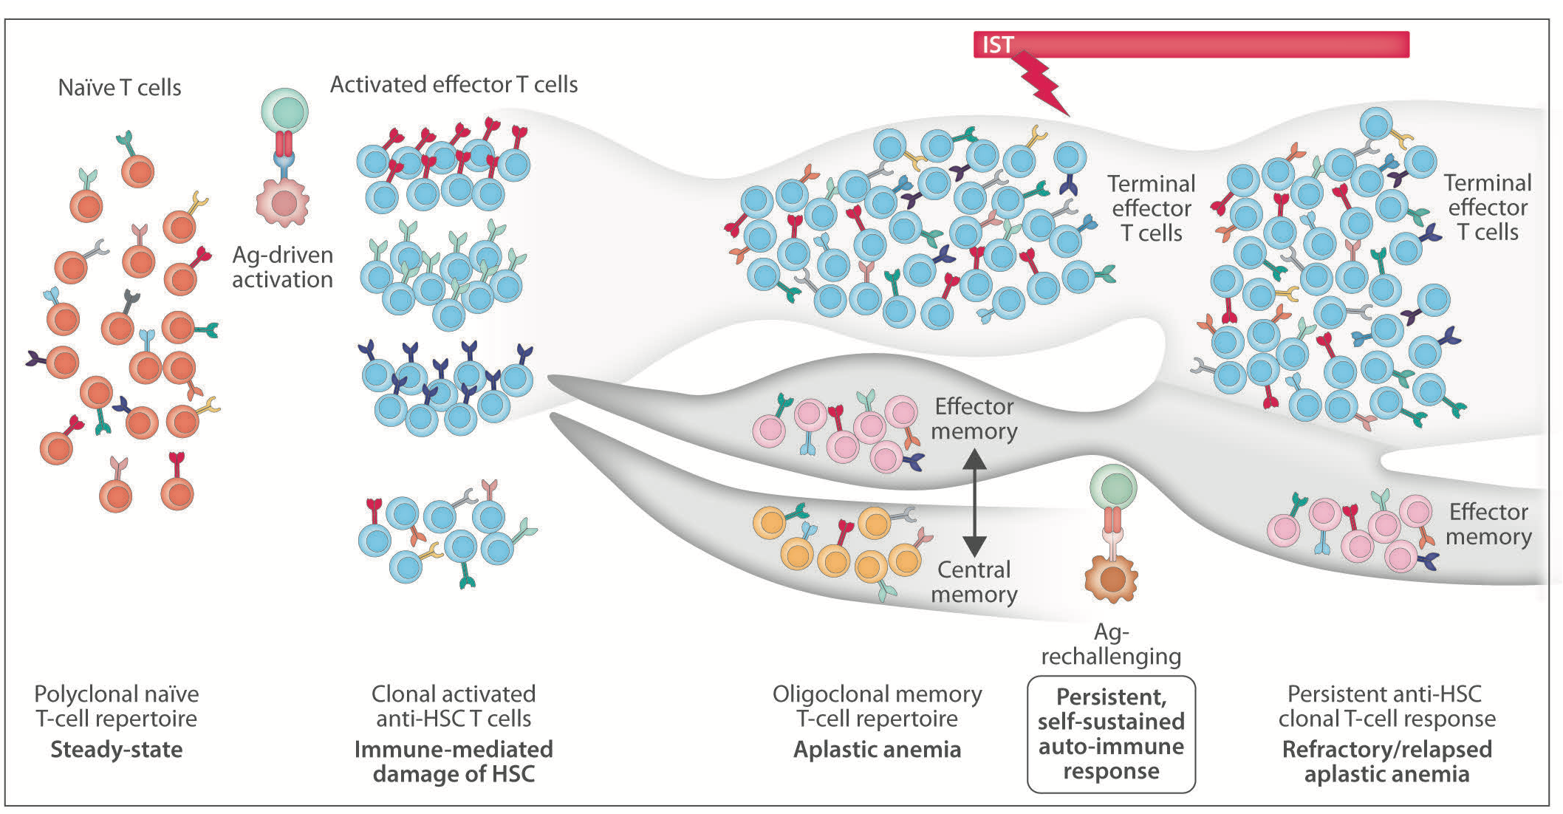
T cell clonality in AA

Slide 9
Frequency and incidence of mutations
ASXL1 (n=12)
DNMT3A (n=8)
BCOR (n=6)
One each of: SRSF2
U2AF1
TET2
MPL
IKZF1
ERBB2
The median allele burden was 20% (range, 1.5–68%)
All heterozygous except one hemizygous BCOR
41% of mutations had <10% clone
Mutations detected were missense (n=12), nonsense (n=12), frameshift (n=6), non-frameshift deletion (n=1) and splice-site changes (n=1)
UPN | Gene | Mutant allele burden (%) | Variant class | Nucleotide and protein change
70 | ASXL1 | 2 | Stopgain SNV | c.G2026T:p.E676X
81 | ASXL1 | 3 | Stopgain SNV | c.T2324G:p.L775X
88 | ASXL1 | 7 | Frameshift deletion | c.2126delC:p.A709fs
2 | ASXL1 | 30 | Frameshift insertion | c.1927_1928insG:p.G643fs
16 | ASXL1 | 30 | Frameshift insertion | c.2469_2470insAG:p.L823fs
107 | ASXL1 | 30 | Stopgain SNV | c.T2468G:p.L823X
40 | ASXL1 | 31 | Non-frameshift deletion | c.2894_2896del:p.965_966del
69 | ASXL1 | 34 | Stopgain SNV | c.2077T:p.R693X
79 | ASXL1 | 36 | Stopgain SNV | c.G2026T:p.E676X
66 | ASXL1 | 37 | Frameshift deletion | c.2433delT:p.N811fs
6 | ASXL1 | 38 | Stopgain SNV | c.C2242T:p.Q748X
29 | ASXL1 | 41 | Stopgain SNV | c.G4068A:p.W1356X
142 | DNMT3A | 1.5 | Non-synonymous SNV | c.C5644T:p.R882C
129 | DNMT3A | 5 | Non-synonymous SNV | c.G2207A:p.R736H
130 | DNMT3A | 5 | Non-synonymous SNV | c.G2645A:p.R882H
97 | DNMT3A | 7 | Non-synonymous SNV | c.C5644T:p.R882C
93 | DNMT3A | 8 | Stopgain SNV | C2311T:p.R771X
18 | DNMT3A | 31 | Non-synonymous SNV | c.C2644T:p.R882C
2 | DNMT3A | 42 | Non-synonymous SNV | c.C1540G:p.L514V
64 | DNMT3A | 47 | Non-synonymous SNV | c.C2644T:p.R882C
21 | BCOR | 5 | Stopgain SNV | c.C526T:p.Q176X
140 | BCOR | 5 | Frameshift deletion | c.4760delC:p.P1587fs
73 | BCOR | 6 | Frameshift insertion | c.4834_4835insC:p.L1612fs
70 | BCOR | 14 | Stopgain SNV | c.T912G:p.Y304X
94 | BCOR | 30 | Splice site | Splice site c.3052-2A>G
33 | BCOR | 68 | Stopgain SNV | c.G4832A:p.W1611X
2 | ERBB2 | 44 | Non-synonymous SNV | c.G922A:p.V308M
19 | IKZF1 | 14 | Non-synonymous SNV | c.C640G:p.H214D
46 | MPL | 10 | Non-synonymous SNV | c.G1544T:p.W515L
10 | SRSF2 | 20 | Non-synonymous SNV | c.C284T:p.P95L
5 | TET2 | 5 | Stopgain SNV | c.C3100T:p.Q1034X
67 | U2AF1 | 19 | Non-synonymous SNV | c.C101A:p.S34Y
Kulasekararaj AG et al. Blood 2014;124:2698–2704
Notes:
All mutations were validated by either Sanger sequencing and/or 454 sequencing.

Slide 10
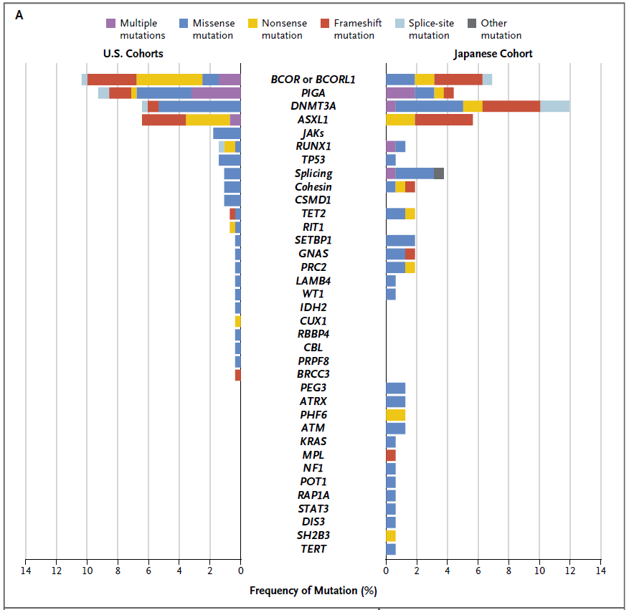
Somatic mutations identified by targeted sequencing
Somatic mutations in 156/439
(36%) patients:
BCOR/BCOR-L1 (9.3%)
DNMT3A (8.4%)
PIG-A (7.5%)
ASXL1 (6.2%)
Somatic mutations excluding
PIG-A in 24% patients
77%
Yoshizato T et al. N Engl J Med 2015;373:35–47
Notes:
Summary of the SMs identified by targeted sequencing, in the combined US cohorts from NIH and Cleveland clinic, and the Japanese cohort from Kanazawa University. Shows frequency of the individual mutated genes and the type of mutation in each gene.

Slide 11
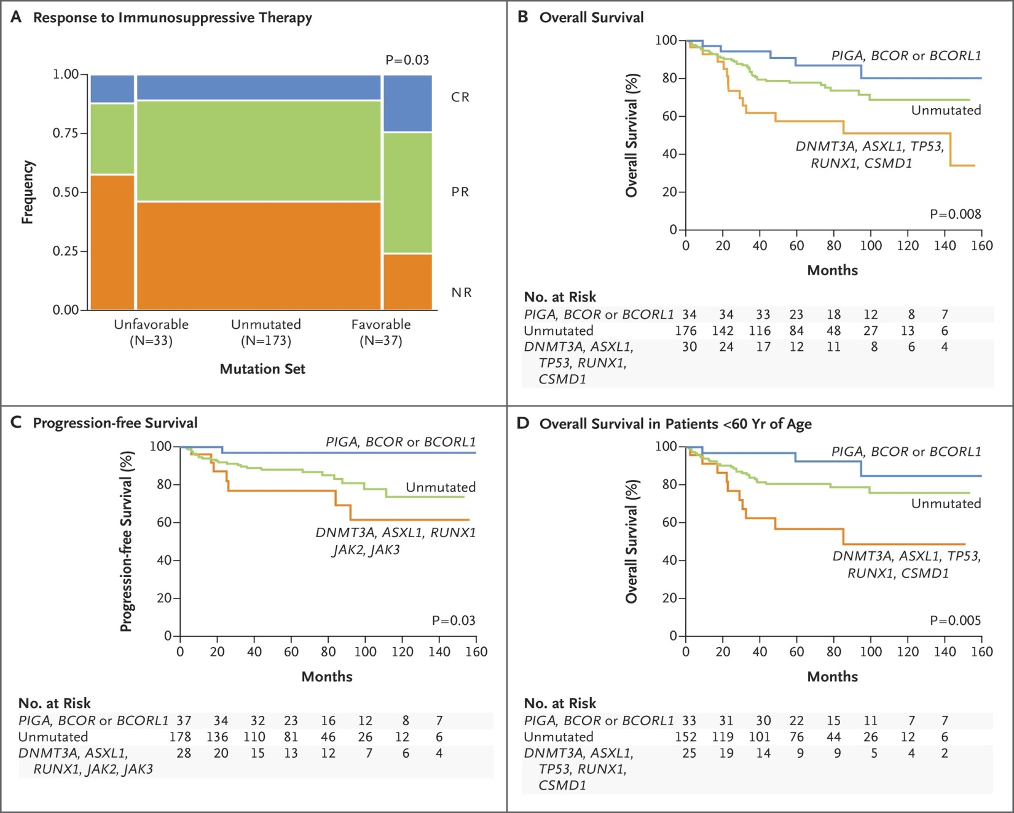
Overall survival after immunosuppressive therapy for SAA - Impact of somatic mutations
Clinical Correlations with Somatic Mutations.
‘Favourable’ mutations
‘Unfavourable’ mutations
All patients
Potential candidates for
early HSCT in future studies?
Patients aged
< 60 years
Stable and fluctuant
Somatic Reversion
Adaptation by aneuploidy
Yoshimato et al. NEJM 2015;373:35

Slide 12
CLONAL HEMATOPOIESIS IN SAA: >12 YEAR COURSE
NIH075 74 y.o. male
80
24
30
20
60
18
22.5
15
40
10
12
Plt (x10⁴/μl)
Hb (g/dL)
15
ARC (x10⁴/μl)
20
6
7.5
5
0
0
0
0
0.5
OR51A4
UBR4
EPHA5
KCNH2
CYP24A1
COBL
TSC22D1
LARGE
COG1
FZD8
PDE4D
RPE65
FAHD2B
GARS
NRK
YTHDF2
EYA4
CUL4B
0.4
U2AF1
0.3
ASXL1
*
*
TET2
BCOR
0.2
EHD2
SETBP1
0.1
0.0
Dx
0.5
1
2
3
4
5
6
7
8
9
10
11
12
yrs
hATG
PR
Gradual transfusion independence
CsA

Slide 13
Mutational profile of AA and its evolution following IST¹
Clinical Significance
Hypoplastic MDS or Overlap AA/MDS (?)
Progression to MDS
?Consider early allogeneic transplantation
Clonal size and frequency
MDS
Overlap
AA/MDS
DNMT3A/ASXL1
IST
Time and disease course
CHIP
Recovery of normal
haemopoiesis
AA
Frequency of four commonly mutated genes in AA from two studies^{2,3}
Age related clonal haemopoiesis
Top four genes | Kulasekararaj et al. | Yoshizato et al.
DNMT3A | 8.3% | 8.4%
ASXL1 | 8% | 6.2%
BCOR/BCORL1 | 4%* | 9.3%
PIGA | N/A | 7.5%
Median VAF | 20% | 9.3%
Normal haemopoietic stem cell (HSC)
Dysplastic HSC
Dysplastic HSC with single mutation
Dysplastic HSC with multiple mutations
*BCORL1 not analysed
NA-PIGA not done for the whole cohort
VAF-variant allele frequency
CHIP-Clonal haemopoiesis of indeterminate potential
IST-immunosuppressive therapy
Mufti GJ, Kulasekararaj AG, Marsh JCW. N Engl J Med 2015;373:1673–1676;
Kulasekararaj AG et al. Blood 2014;124:2698–2704;
Yoshizato T et al. N Engl J Med 2015;373:35–47

Slide 14
Clonal signature of AA compared to ageing and MDS
Stanley et al, Brit. J. Haem. 2017

Slide 15
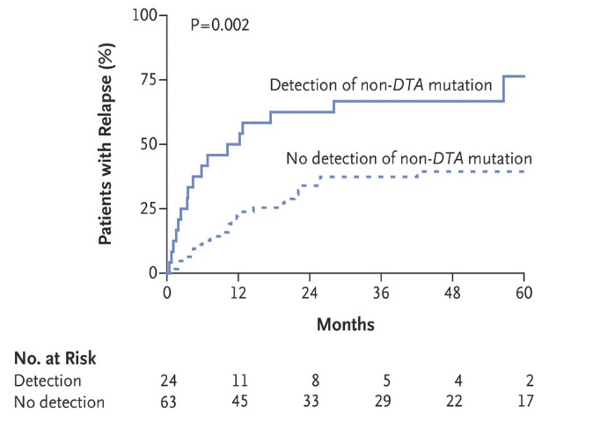
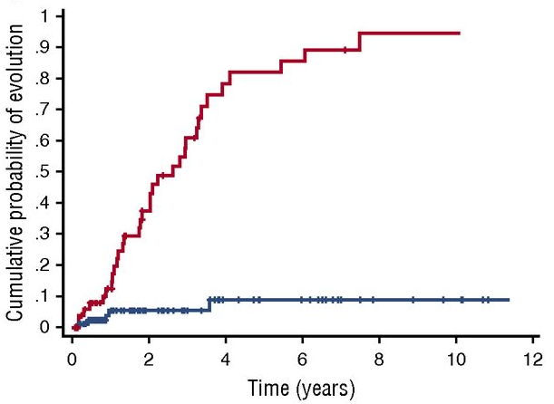
Routes to Clonal Haemopoiesis
mutated
Post-
Transplant
Donor engrafted CHIP
unmutated
ICUS vs IDUS
Pre-leukaemic vs
CHIP vs germline
CCUS vs ICUS
vs MDS
AML
Previous
Cancer +/-
chemo
Old Age
Clonal Haemopoiesis
.
ARCH vs CHIP vs CHOP
AA
Post-
Eltrombopag/
IST
100
PIGA, BCOR or BCORL1
80
60
Unmutated
Overall survival (%)
40
DNMT3A, ASXL1, TP53, RUNX1, CSMD1
20
0
P=0.008
0
20
40
60
80
100
120
140
160
Months

Slide 16
Clonal Haematopoiesis is more common in AA (>70%)
CH is the rule rather than exception!!
Very ubiquitous
Babushok, Blood 2019

Slide 17
Clonal haematopoiesis in acquired AA
HSCs
Clonal haematopoiesis
CHIP/CCUS/ICUS
Depleted stem cell pool
Ageing
Oligoclonal haemopoiesis
Environmental
insult
↑ Telomere loss
Immunosuppressive therapy
Eltrombopag & GCSF
HLA Class I risk alleles
Age
Good prognosis:
PNH, +8, del(13q)
BCOR/BCORL1
Poor prognosis:
-7,RUNX1, TP53, ASXL1, SETBP1, multiple & high VAF
Neutral/Unknown/Fluctuant:
ASXL1, DNMT3A
Inflammatory/
immune response
Proliferative pressure
↑ Th1
↑ Th17
↓Tregs
Malignant transformation
Autoreactive
immune response
Immune escape
↑ Tregs
Genomic instability
Immune-mediated surveillance
Surveillance
Selection
Subversion
Kulasekararaj et al, modified and adapted from Blood 2014

Slide 18
Somatic Mutations in AA- Pre-RACE trial
July 2015 - April 2019 (period of the trial)
Why should there be ‘baseline’/ ‘acquired’ somatic mutations in a purely ‘autoimmune’ disease? (Mustjoki & Young, NEJM 2021)
Do presence of baseline somatic mutations increase the risk of ‘malignant’ transformation to MDS/AML during the course of AA? (Kulasekararaj, Blood 2014)
What impact would Eltrombopag have on stimulating ‘mutated’ clones?
Will any of these translate into worse clinical outcome? ( 2years vs 5 years vs 15 years)
Could clonal haematopoiesis be ‘paradoxically’ advantageous?!

Slide 20
RACE design
The RACE trial is an investigator-driven, open-label, phase 3, randomized trial comparing the combination of hATG, CsA, and eltrombopag with IST alone in patients with SAA
Treatment
Key inclusion criteria
Age ≥ 15 years
SAA or vSAA defined by
at least two of the following
ANC < 0.5 × 10⁹/L (SAA) or < 0.2 × 10⁹/L (vSAA)
Platelet count < 20 × 10⁹/L
Reticulocyte count < 60 × 10⁹/L
Hypocellular BM (cellularity < 30%) without evidence of fibrosis or malignant cells
Arm A (n = 101): IST
hATG (40 mg/kg for 4 days)
+
CsA (5 mg/kg/day)
Primary endpoint
Hematologic CR at 3 months
Key secondary endpoints
OS
Hematologic response at 6 months
Cumulative incidence of clonal evolution
Number and allele burden of somatic myeloid mutations
Randomization 1:1
Arm B (n = 96): IST + eltrombopag
hATG (40 mg/kg for 4 days)
+
CsA (5 mg/kg/day)
+
Eltrombopag (150 mg/day from Day 14 until 6 months or 3 months in case of early CR)
Central laboratory King’s college, London
Stratification based on disease severity age and center
ANC, absolute neuthrophil count; vSAA, very severe aplastic anemia.

Slide 21
RACE versus NIH Study
 | NIH study¹ | RACE²
Study design | Non-randomized, historically controlled | Randomized, controlled
CsA treatment duration | 6 months + low dose for up to 24 months | 1 year + low dose for up to 24 months
Eltrombopag initiation | On Day 1 in Cohort 3 On Day 14 in Cohort 1 and 2 | On Day 14
Eltrombopag treatment duration | 6 months in Cohort 1 and 3 3 months in Cohort 2 | 6 months 3 months with early CR
Primary endpoint | CR and PR at 6 months | CR at 3 months
Criteria for response | PR: transfusion independency not needed | PR: transfusion independency required
Minimum age of inclusion, years | 2 | 15
Median age of patients, years | 32 | 53
1. Townsley DM, et al. N Engl J Med. 2017;376:1540-50.
2. Peffault de Latour R, et al., NEJM, Jan 2022

Slide 22

Research Aims
Serial blood and BM sampling in both treatment arms
The evolving clonal architecture and mutational hierarchy
- Does the molecular signature (somatic mutations) predict for early MDS/AML?
- Is there a difference between the 2 treatment arms?
- What is the significance of small mutant clones?
Immune signature using high resolution immunophenotyping
- What is the signature for response and relapse?
Correlation of immune and molecular signatures
-HLA typing and TCR sequencing
- What is the role of immune response in modulating fate of mutant clones?
King’s College London (KCL) : Central laboratory and Tissue Bank for RACE research
CRUK Biomarker Project Grant C1031/A22324

Slide 23
High-sensitivity mutation detection panel
31 gene targets (Molecular Bar Code_31_panel)
Agilent Haloplex HS panel
HiSeq3000 and NovaSeq, average depth >2000X
MBC/UMI added to achieve greater sensitivity
and removed sequencing artefacts
Identify mutations at lower limit variant
allele frequency (VAF) of 1% (0.3% VAF)
Core panel of 31 genes (0.3-1% and >1% VAF)
Extended panel of 291 genes
VAF of 0.3-0.5% (UMI/ECS based)
Small clones validated by ddPCR (0.02- 0.2% VAF)
Notes:
Enriched in AA, MDS, AML, CHIP

Slide 24
Cytogenetic and mutational data
 | Total N=197 | hATG + CsA (Arm A) N=101 | hATG + CsA + EPAG (Arm B) N=96
Age (median, min-max) | 53 (15-81) | 52 (15-81) | 55 (16-77)
Age >40 – no (%) | 132 (67%) | 65 (65) | 67 (70)
Cytogenetic abnormalities (n=170)
Normal, n (%) | 125 (74) | 64 (74) | 61 (73)
Abnormal$, n (%) | 13(8) | 7 (8) | 76(7)
Failed, n (%) | 32 (19) | 15 (17) | 17 (20)
No of patients with somatic myeloid mutations#, n/n analyzed (%) | 47/156 (30%) | 23/78 (29%) | 24/78 (31%)
Cytogenetics: -Y, +8 and 20q
Mutations: Excluding patients with isolated PIGA mutations and VAF of >1% (31 gene panel)

Slide 25
Clonal evolution – myeloid malignancy
Arm | Age | AA | Cytogenetics/Karyotypic abnormalities |  |  | Clonal evolution | MDS | somatic mutations +VAF |  |  | ORR |  | Relapse
 |  |  | Baseline | 6 months | 24 months |  |  | Baseline | 6 months | 24 months | 3 mo | 6 mo
A | 58 | SAA | 46XY | 46, XY, +Y, -7[4]/ 46, XY[11] | NA | Yes- 6 mo | No | BCOR 0.1%, DNMT3A 1.24%, TET2 0.1% | BCOR 5.01%, DNMT3A 13.24% TET2 13.29% | NST | PR | CE | Yes
B | 19 | SAA | 46,XX[16] | Not done or failed (del13q at 12 &18 months) | Normal | Yes- 12 mo | Yes | PIGA 7.74% | PIGA 7.15% | NST | PR | CR | No
B | 62 | SAA | 46,XY [15] | 46,XY,-13(q13q34)[2]/ 46,XY[18] | Unknown (persistent del13q at 12 and 18 months) | Yes- 6 mo | No | No mutations | No mutations | NST | NR | NR | No
A | 67 | SAA | 46, XY [20] | 45,X,-Y[3]/ 46,XY[17] | 46,XY,del(7)(q22q3?2)[7] /46,XY[18] (No del7q detected 6 and 12 months later) | No | No | No mutations | No mutations | BCOR 1.97% | NR | NR | No

Slide 26
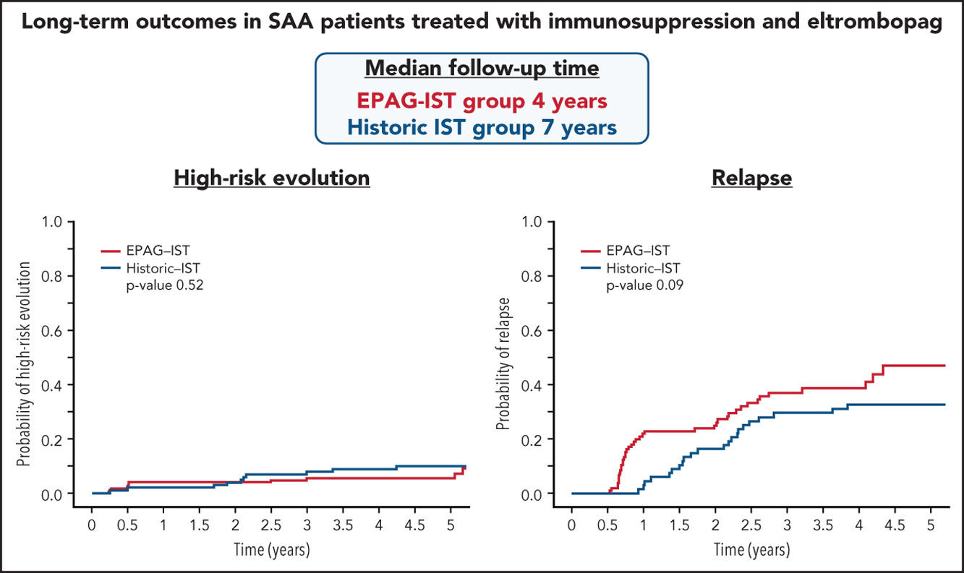
Short Term (2 years)
Medium term (n=178 (4 years)
Clonal evolution
of 15% at 4 years
High risk evolution
(chr 7, complex cyto, MDS/AML) -5.7%
(vs 10.3% in IST group)
Clonal evolution- 8% at 2years
Townsley et al, NEJM 2017 Patel , Blood 2022

Slide 27
High risk clonal evolution
Median to to evolution; 186 days (IST+EPAG) vs 777days (IST only)

Slide 28
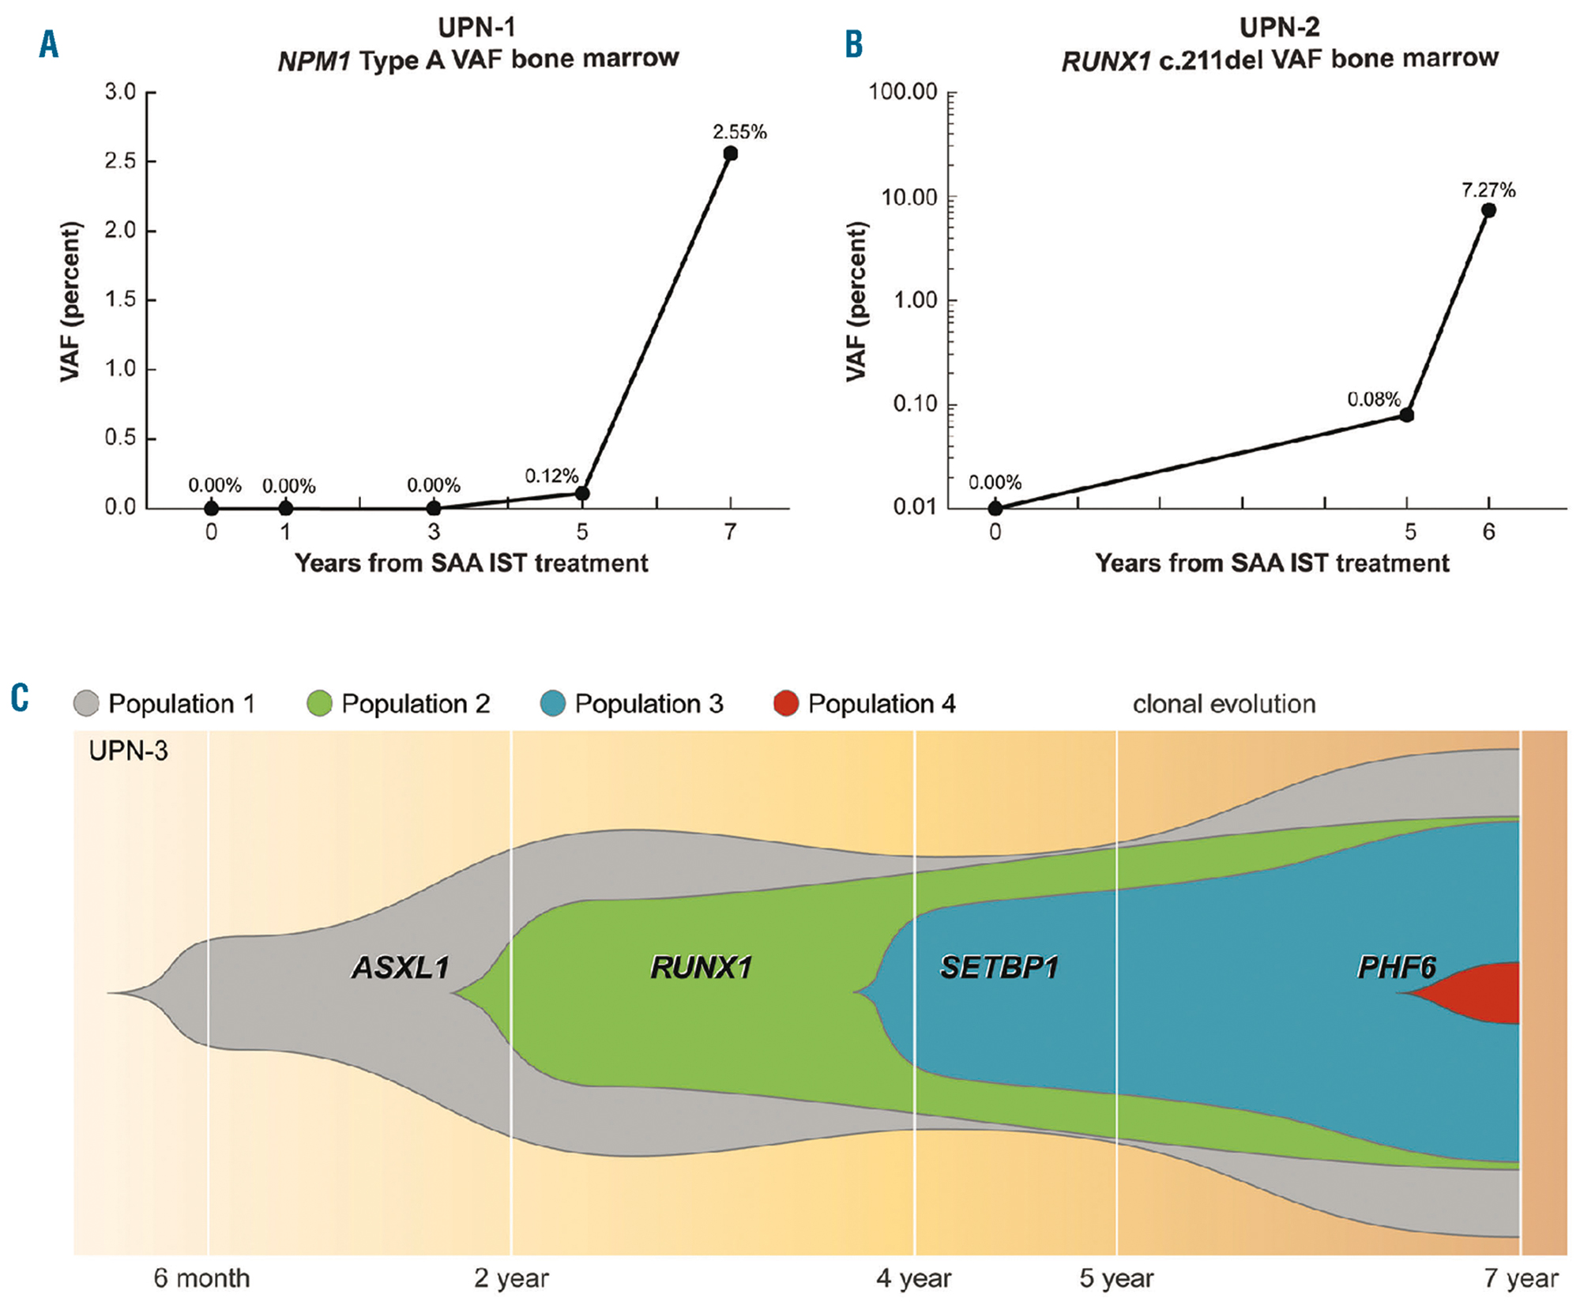

Slide 29
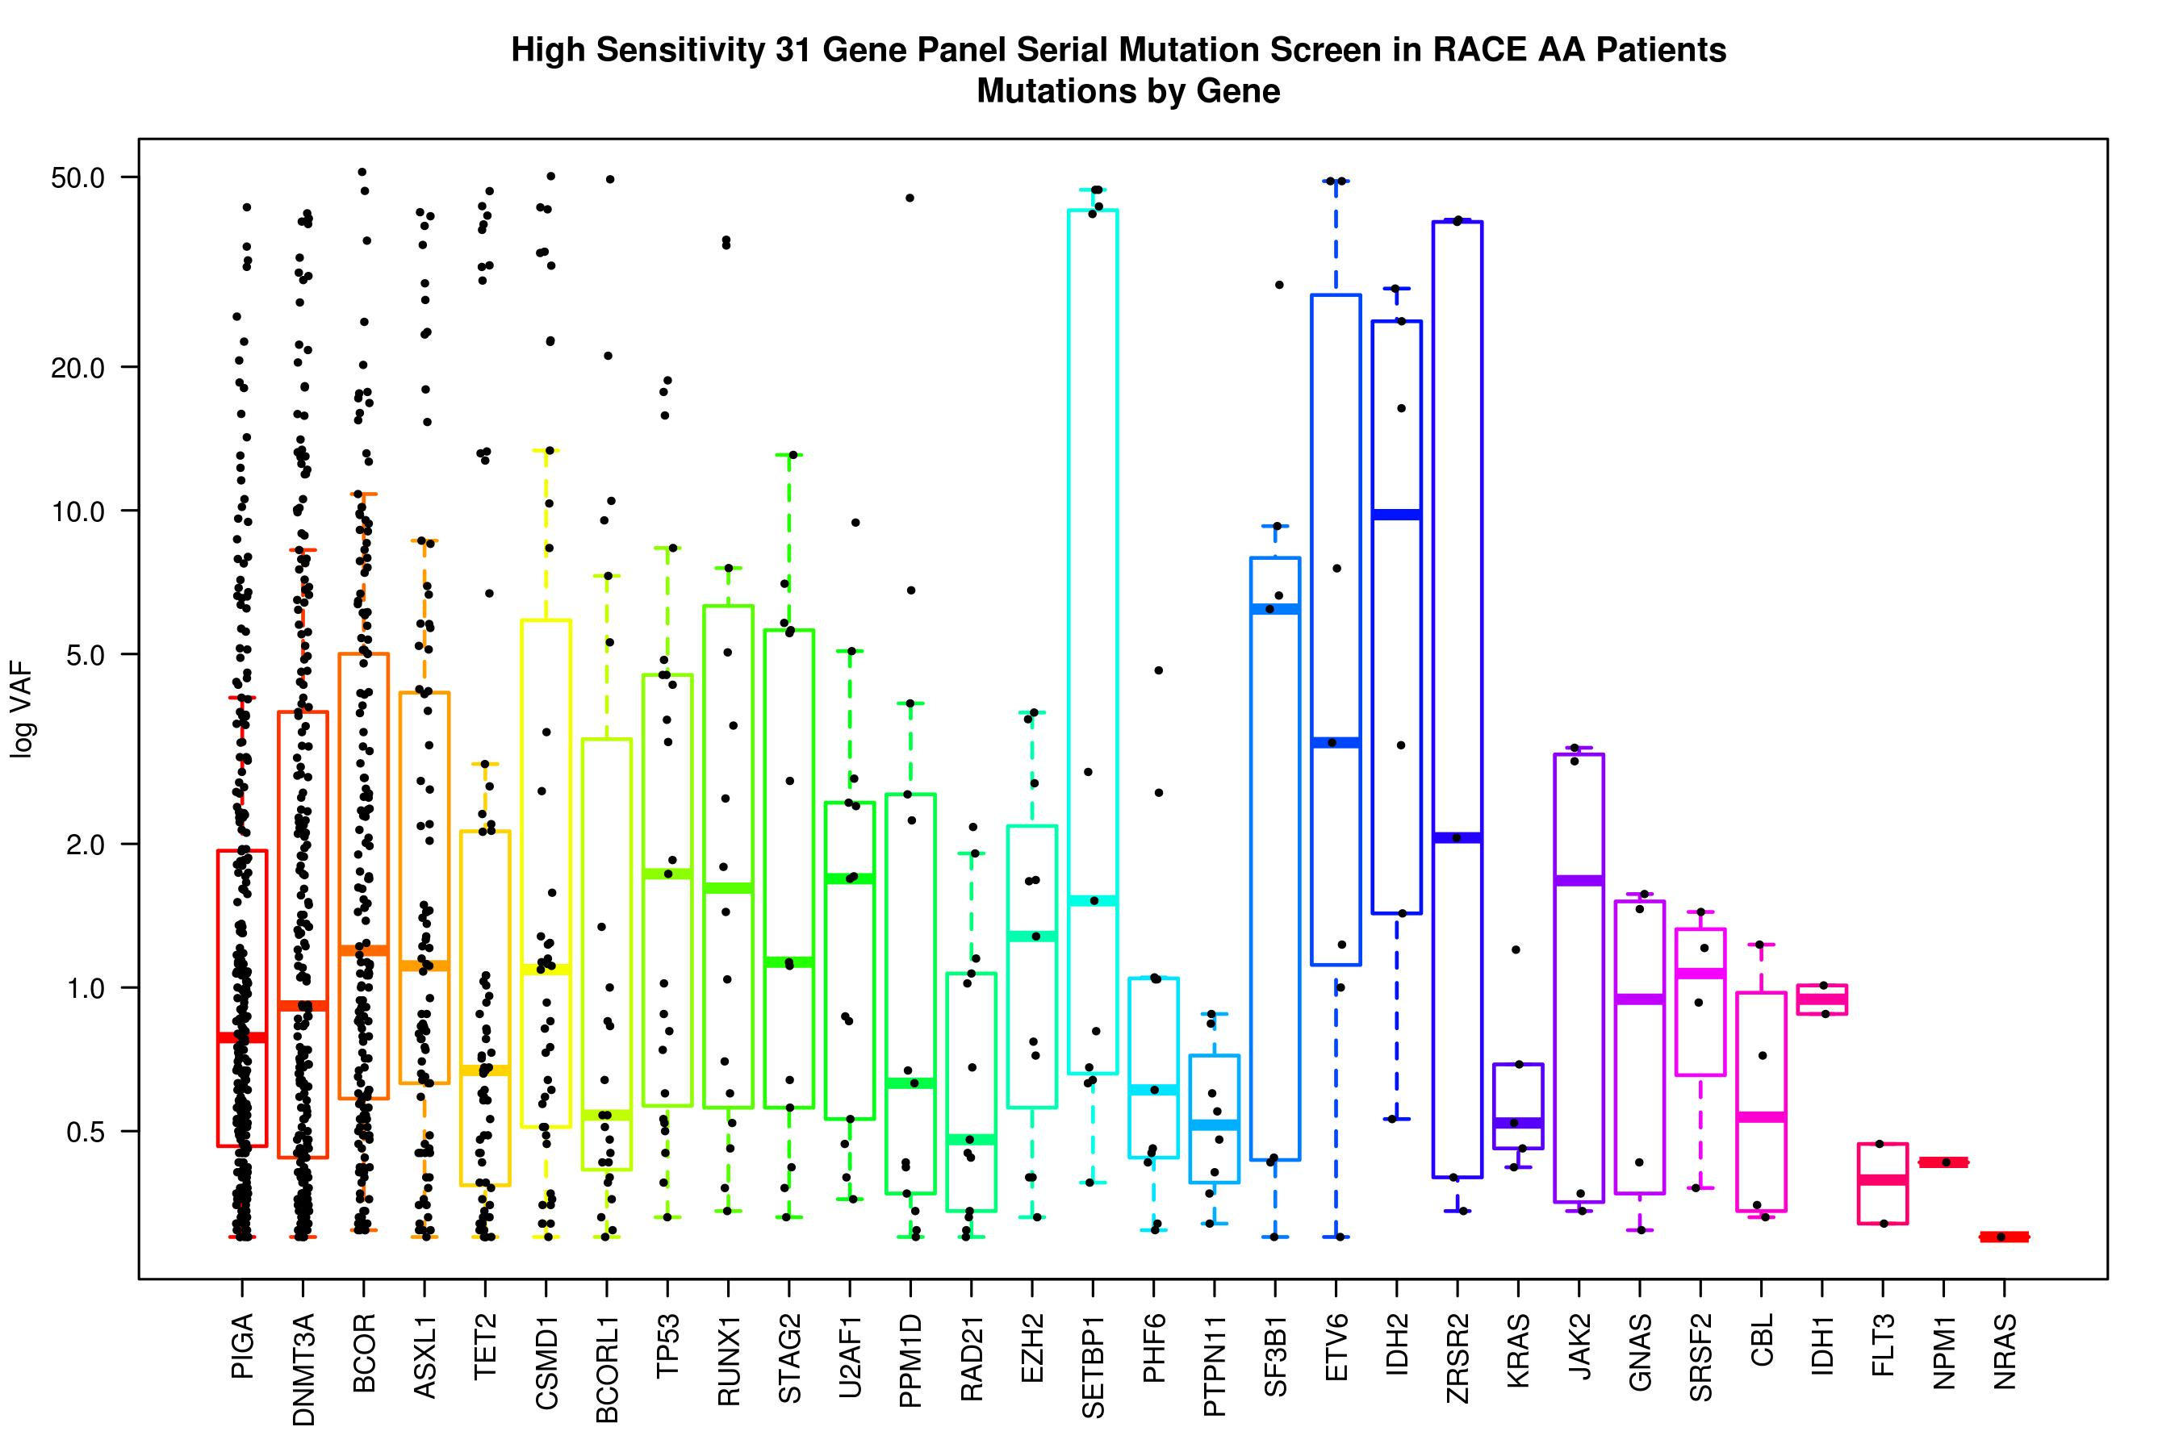

Slide 30
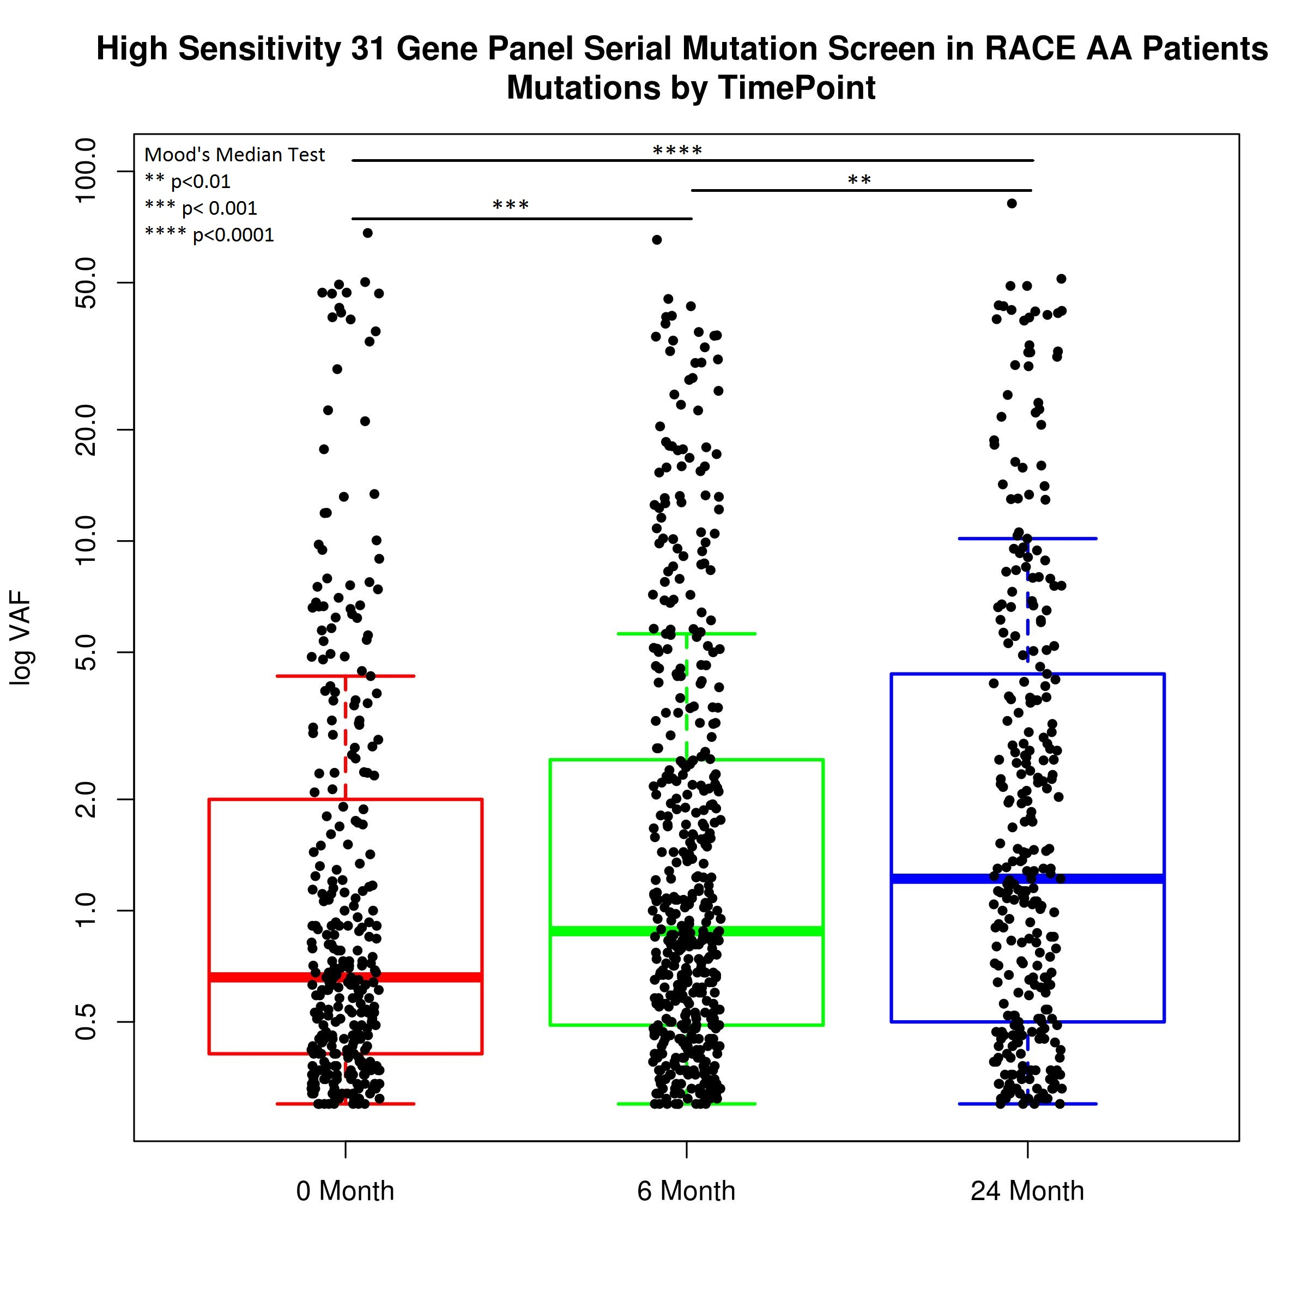
Notes:
vaf by tp increases
0m VAF 0.66% 6m VAF 0.88% 24m VAF 1.22%
These differences are statistically significant, confirmed via Mood's median test

Slide 31
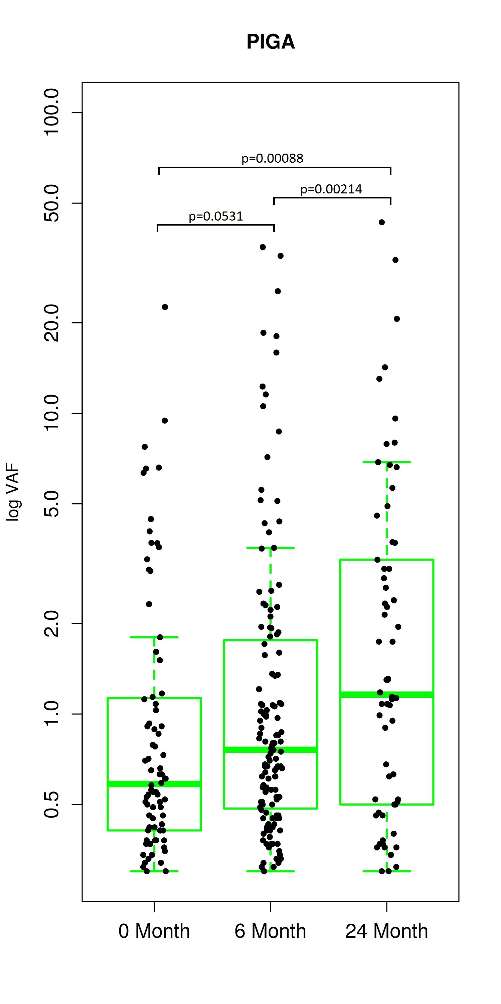
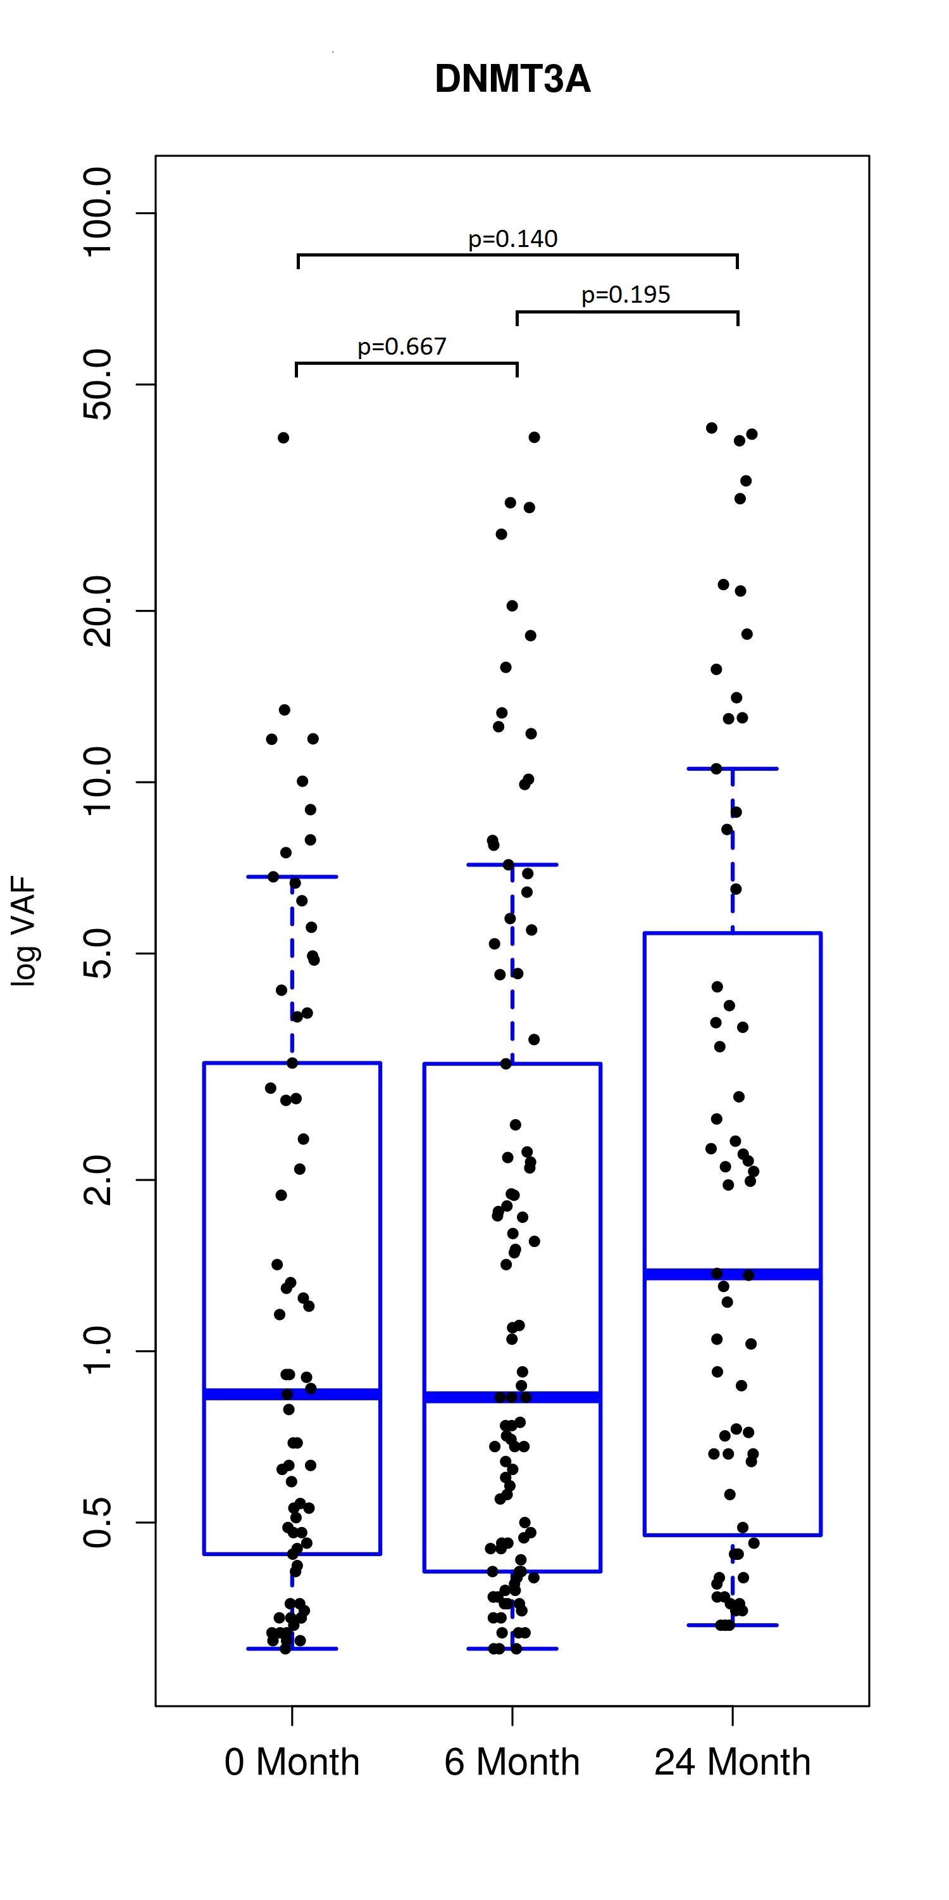
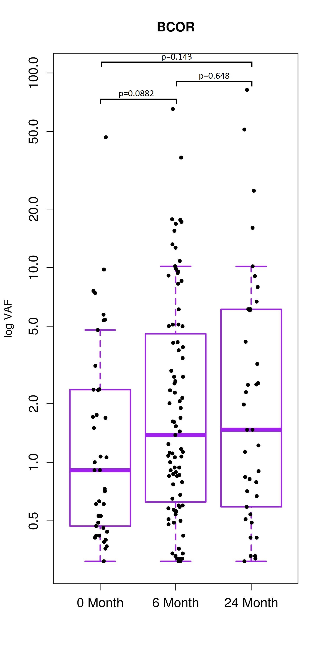
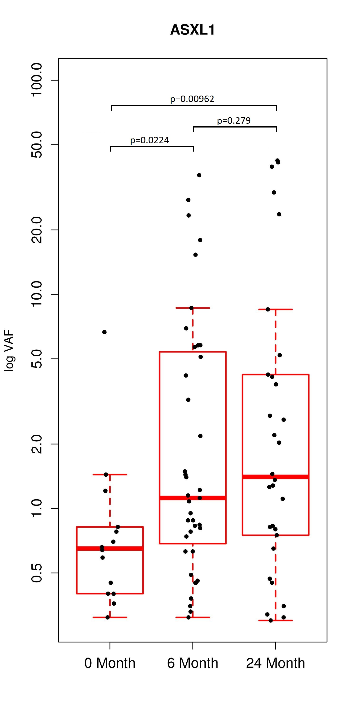

Slide 32
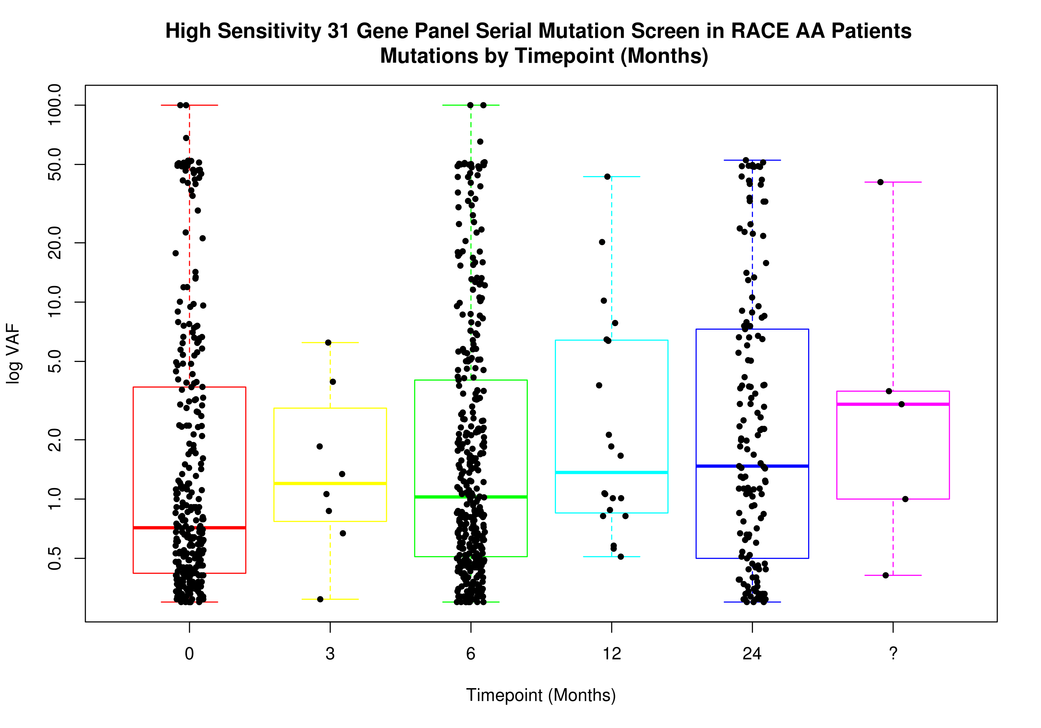
Lower VAF at diagnosis and its interpretation: mutations present at diagnosis
Targeted sequencing of genes at diagnosis of aplastic anaemia (n=96)
None of them had mutations with VAF >10%
Cautious use of mutation calling in clinical practice by sequencing laboratories
Low level clones at diagnosis- IST doesn’t induce mutations!!
Yoshizato et al. NEJM 2015
Kulasekararaj et al,, Unpublished
RACE data, unpublished

Slide 33
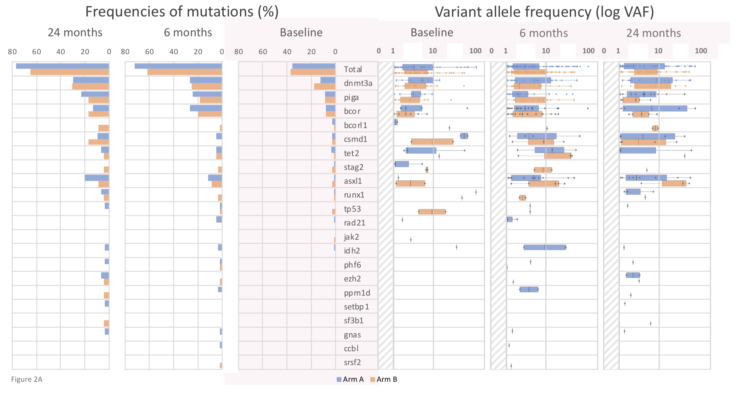
Somatic mutations

Slide 35
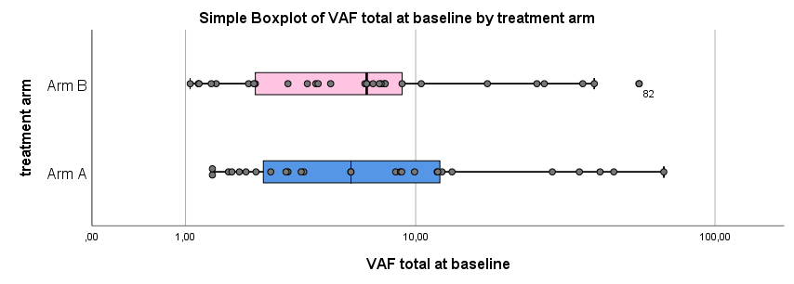
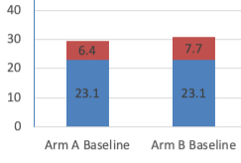
Baseline
Frequency of mutations VAF (log)
N=156

Slide 36
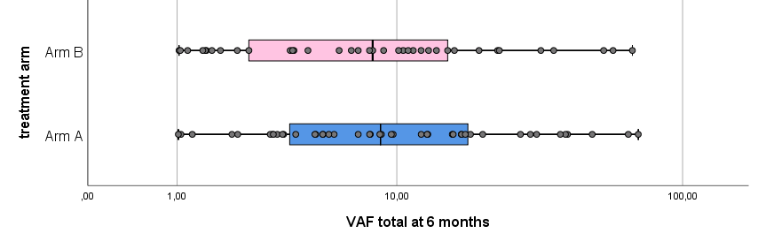
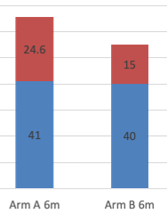
@ 6 months
N=121
Frequency of mutations VAF (log)

Slide 37
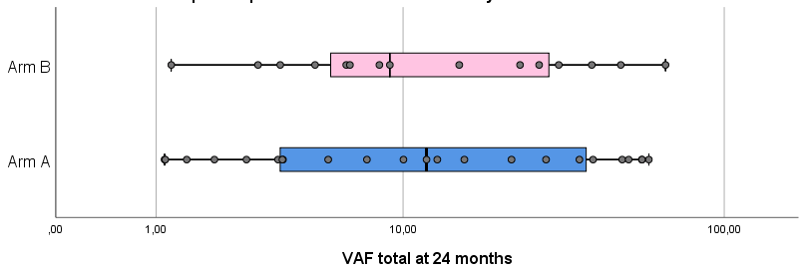
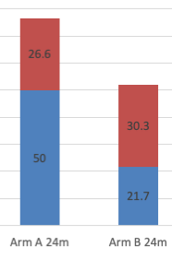
@24 months
Frequency of mutations VAF (log)
N=53

Slide 38
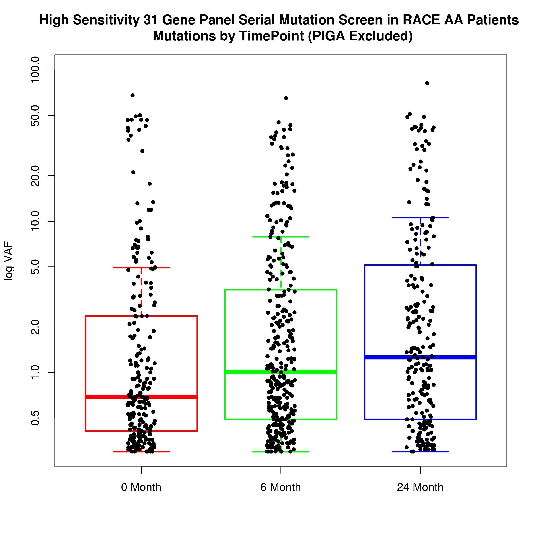
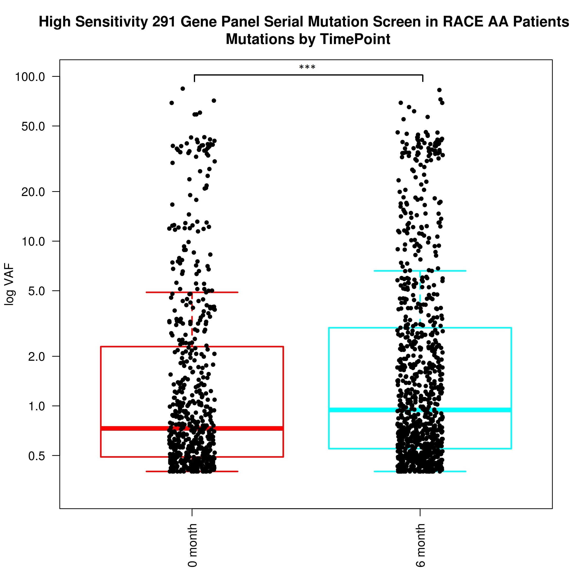
Notes:
It would be interesting to know if both arms of the trial show increasing VAF or if this effect is only seen in arm B, if I remember correctly the % of patients with mutations in each arm was discussed in the NEJM submission, but not the total mutational load in terms of median VAF

Slide 39
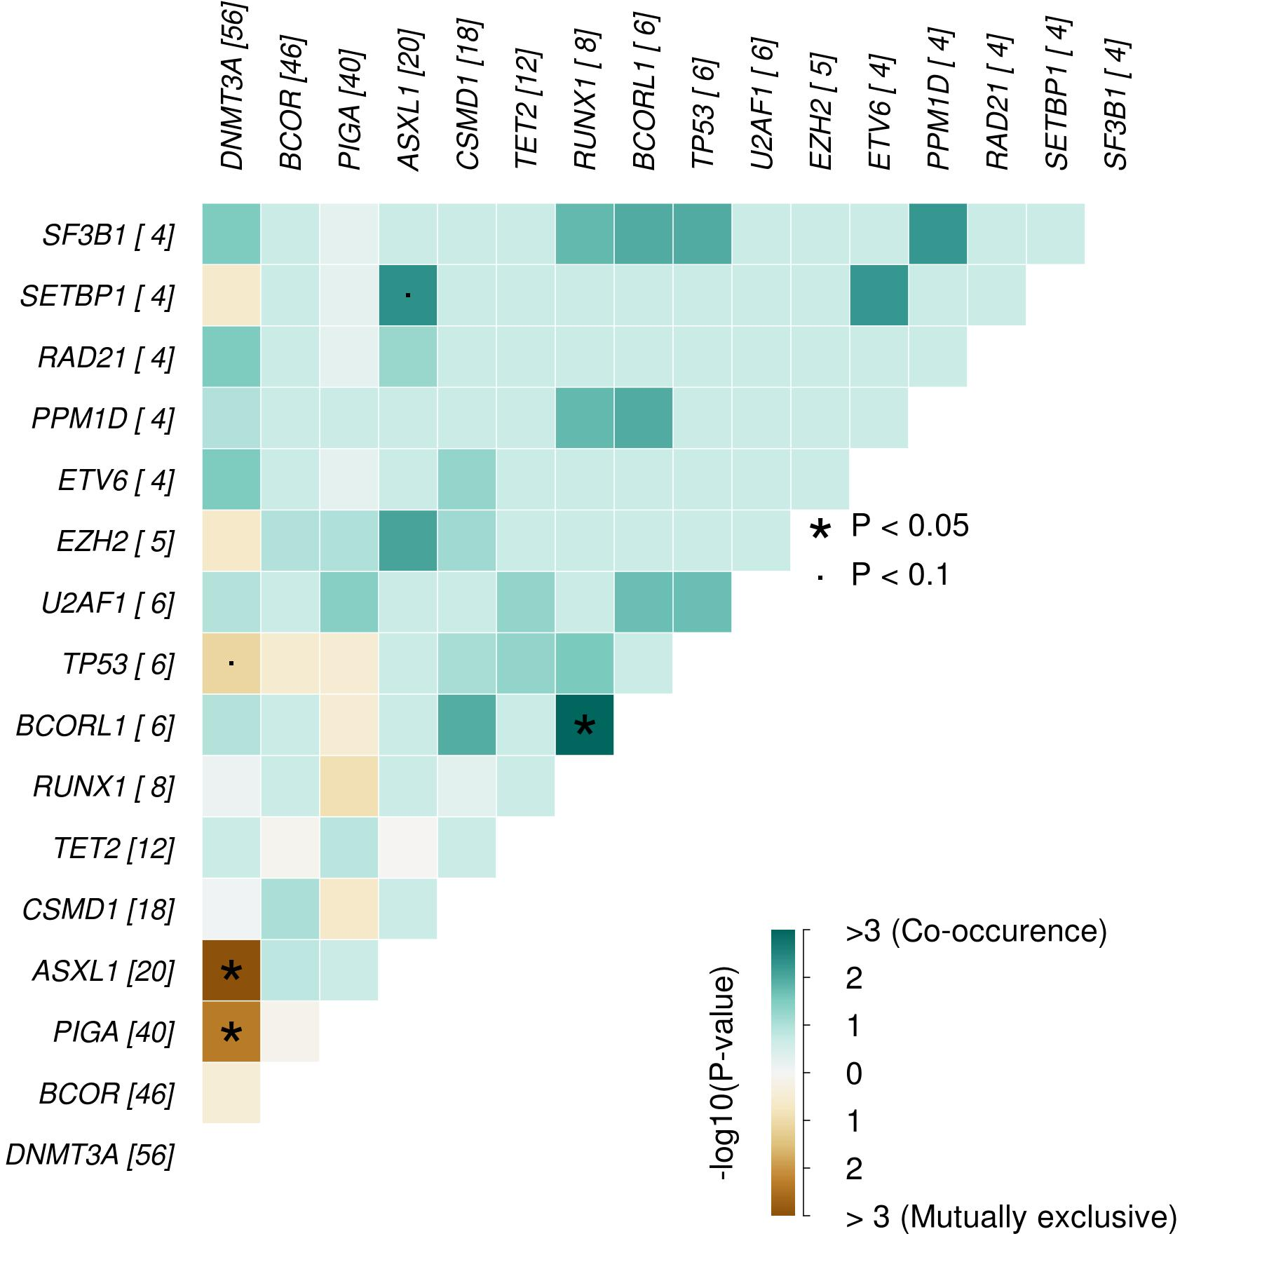
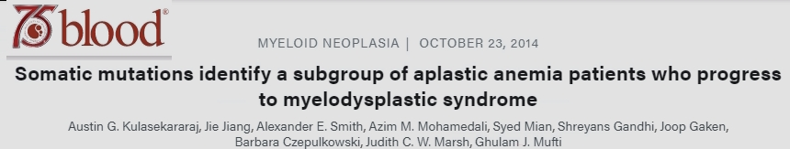
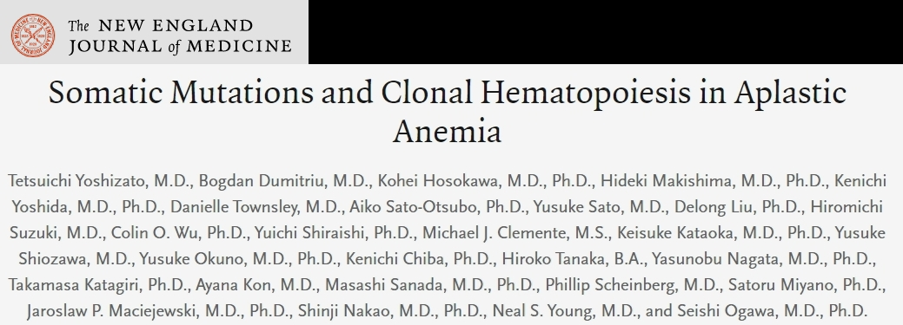
RACE Study: Co-Mutations vs. Mutually Exclusive Mutations
>=1% VAF

Slide 40
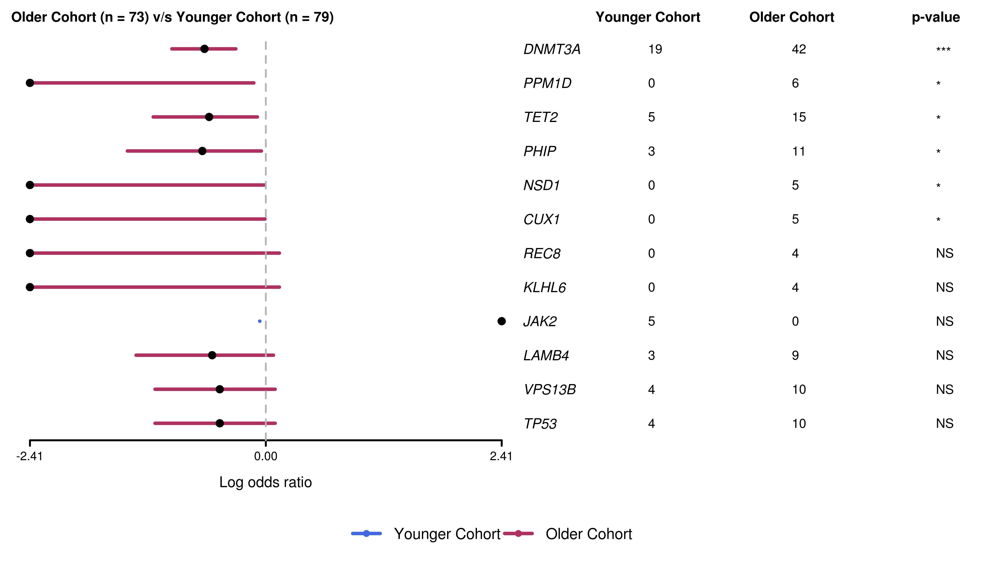
RACE Study: MAFtools Summary (Extended Panel) Younger vs. Older Cohort
<=53
>53
Notes:
DNMT3A is more common in the older patient cohort and that is statistically significant... in addition to that other genes also exhibit this same split – most notably PPM1D, and TET2...this analysis was all done using data with the extended gene panel, but these relationships were all confirmed when we repeated the analysis using the core gene panel data
As a final note, again we think this kind of approach would very interesting to apply for arm A vs. Arm B and responders vs. Non-responders – perhaps certain genes are more localized to one group or the other which indicates perhaps differential mechanisms of pathogenesis

Slide 41
Patients (n=45) analyzed at all 3 time points (baseline/6/24months)- VAF >0.1%, VAF >1% and VAF>5%

Slide 42
Univariate analysis-predictors of response

Slide 43
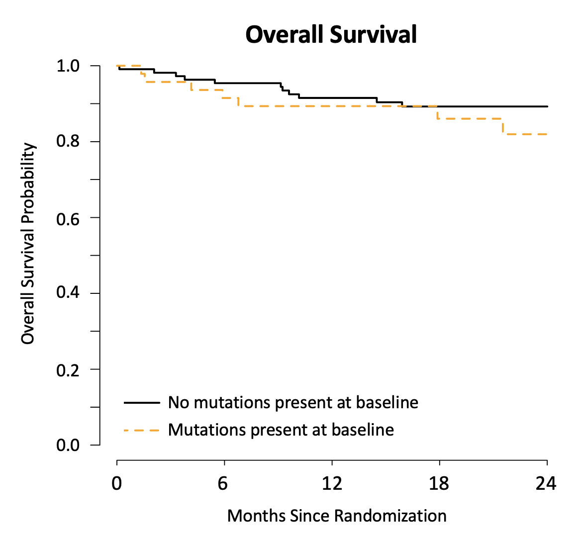
CR/ORR and Overall survival- Mutations at baseline

Slide 44
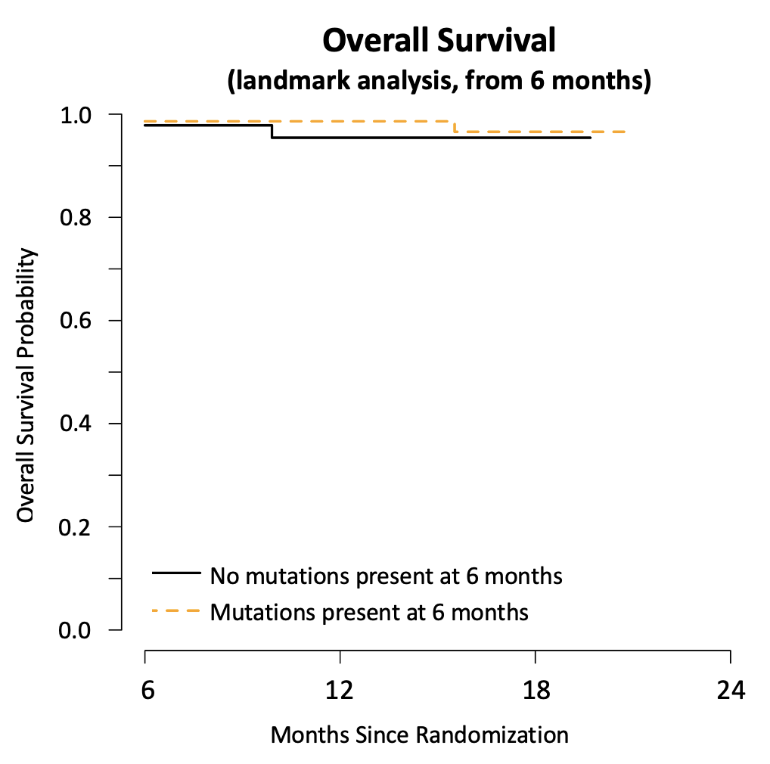
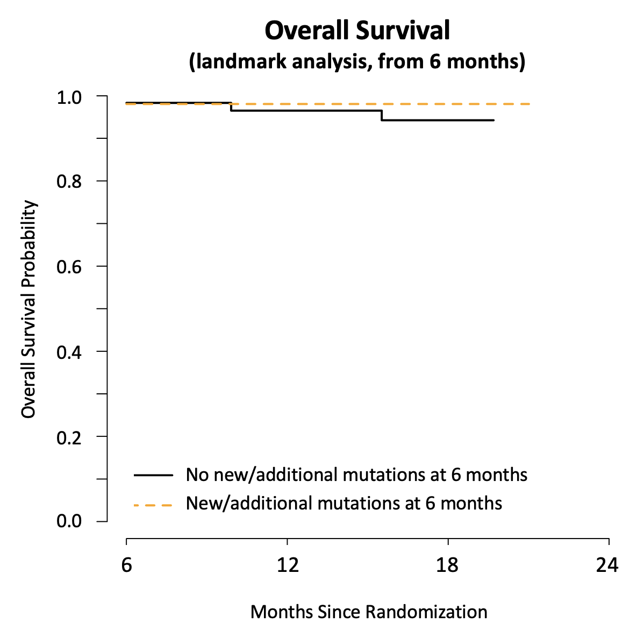
Overall survival and ORR- Mutations at 6 months or new/addl mutations at 6 mo
N=48
N=73
N=62
N=52

Slide 45
Hypoplastic MDS: King’s College Hospital/ University of Pavia Study
Bono E, McLornan D, Travaglino E, Gandhi S, Gallì A, Khan A, Kulasekararaj AJ, Boveri E, Raj K, Elena C, Ireland RM, Bianchessi A, Jiang J, Todisco G, Ferretti VV, Cazzola M, Marsh JCW, Malcovati L, Mufti GJ
Integrated cyto-histological/genetic score (hg score)
Hypoplastic cohort
HypoMDS * (n=278; 28% of all MDS)
Aplastic Anaemia (n=136); 67% had NSAA
MDS Cohort (n=727)
*204, BM cellularity <25%
74, Age-adjusted hypocellularity
ª WHO criteria, 2017
^{b} Splicing genes or comutation
patterns involving TET2, ASXL1
or DNMT3A (Malcovati, 2017)
ROC Analysis
SCORE ≥ 2:
Sensitivity 0.63
Specificity 0.97
Bono E et al. Leukemia. 2019; 33: 2495-2505
Notes:
Using ROC analysis, a score of ≥ 2 gives the highest chance of correctly classifying as hypoMDS.

Slide 46
HLA allele loss in aplastic anaemia
Stanley, BJH 2017

Slide 47
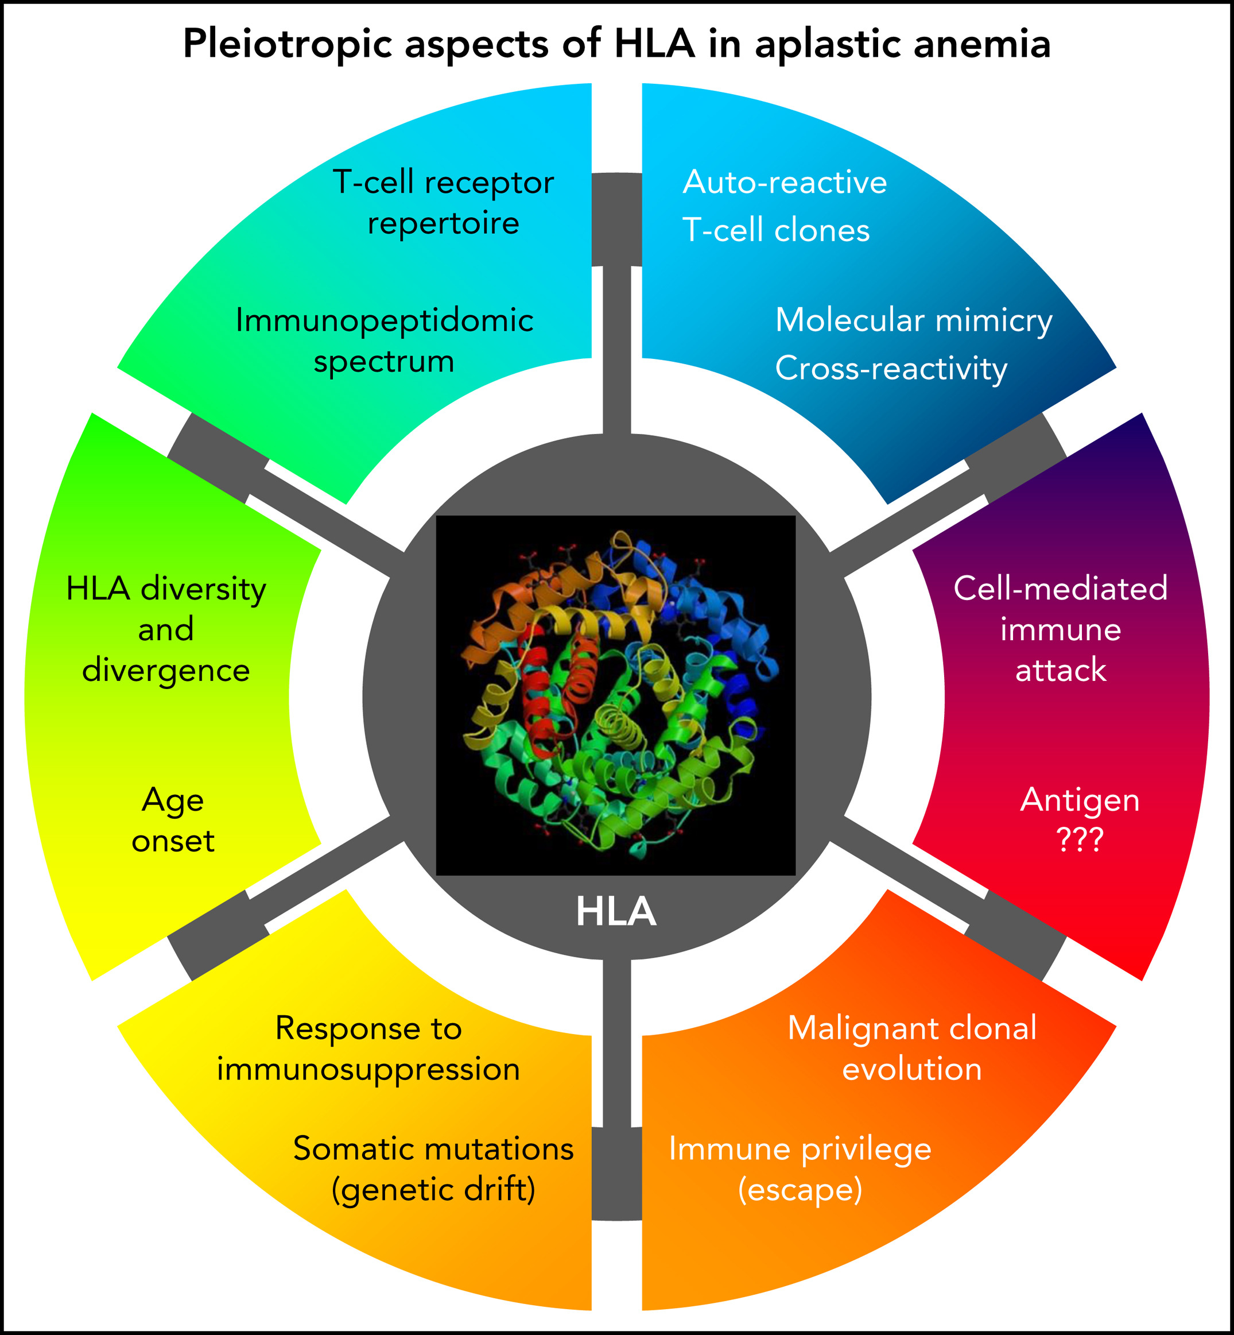
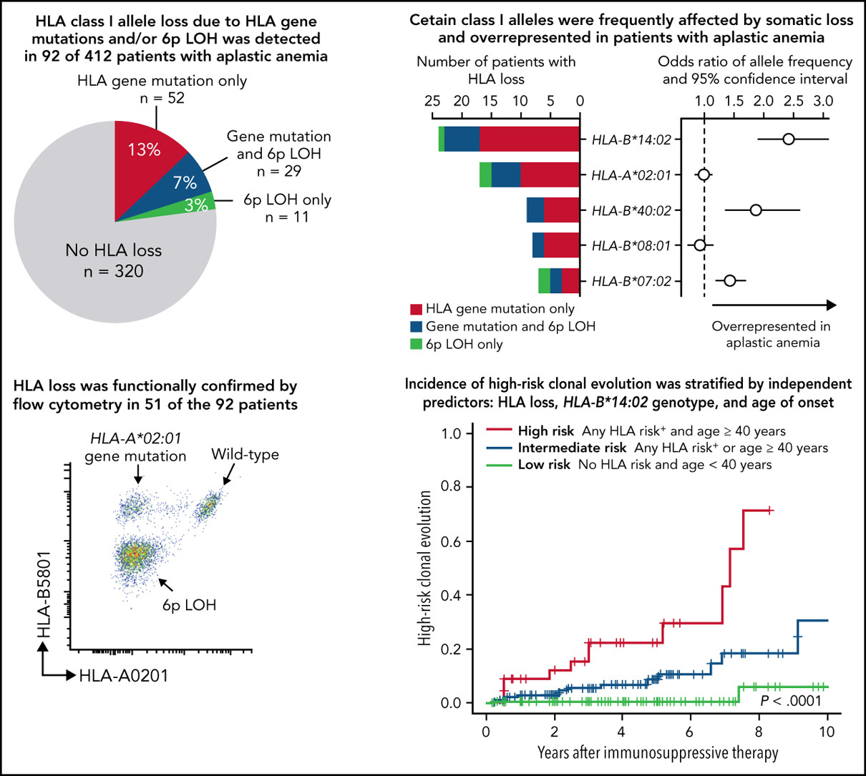
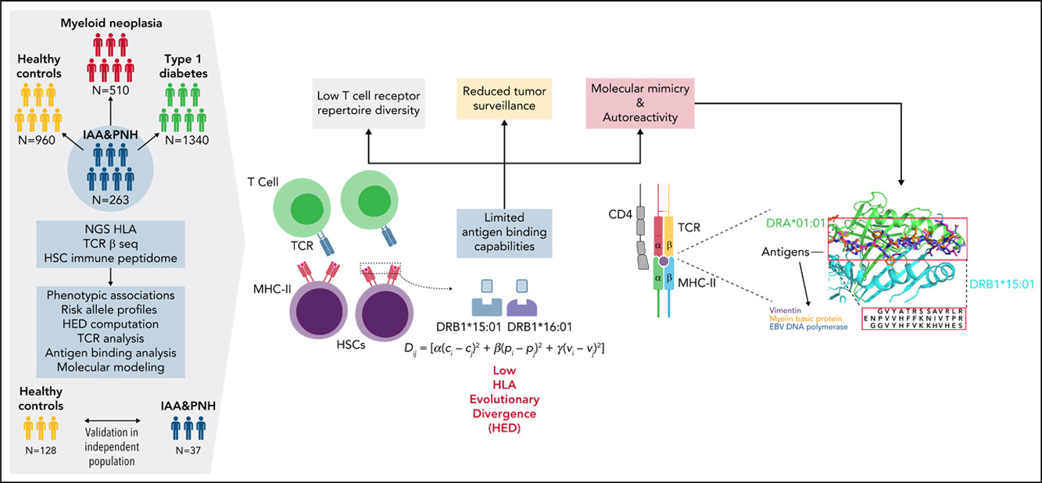
Somatic loss of HLA expression and HLA associations
Zaimoku, Blood 2021, Pagliuca Blood 2021, Risitano Blood 2021

Slide 48
Somatic mutations in AA/MDS predisposition syndromes
Panels for acquired genomic anomalies also include germline predisposition genes (eg GATA2, RUNX1, MPL, CEBPA)
Unlike childhood acquired AA, prevalence of clonal haemopoiesis is very high and develops earlier in inherited BMF
Spectrum is variable and distinct (co-mutations & exclusivity)
Severe Congenital Neutropenia (ELANE)- CSF3R mutations are common
SBDS- TP53 mutations and impacts transplant outcome
‘GATA2’ disorders- ASXL1 and SETBP1 mutations ? Time to allograft
Fanconi anaemia- RUNX1 (rarity of TP53 mutations)
Will it guide therapeutic strategies? (Colon (MMR-deficient), Breast (BRCA/ATM) and evolving role of PARP inhibition in biallelic MBD4 mutated AML)

Slide 49
Summary
Mutations in AA are very common at diagnosis (ubiquitous-rule than exception), many present at low VAF, but large variation in clone size- Biomarkers of clonal haematopoiesis and indicates proliferative stress
Mutations correlate with age, severe AA and higher neutrophil count
Serial sampling from diagnosis to 6 and 24 months shows different patterns, but generally increasing mutational pattern irrespective of response or type of therapy- mechanism for haemopoietic recovery and oligoclonal haemopoiesis (genetic drift rather than selection)
No association of mutations with response or overall survival or transformation to MDS/AML (need RACE2)
No adverse impact of Eltrombopag on mutations (frequency and VAF)
Nearly 60-70% patients harbour mutations, but only 3 cases of cytogenetic evolution ( do not use mutations to change diagnosis and treatment)

Slide 50










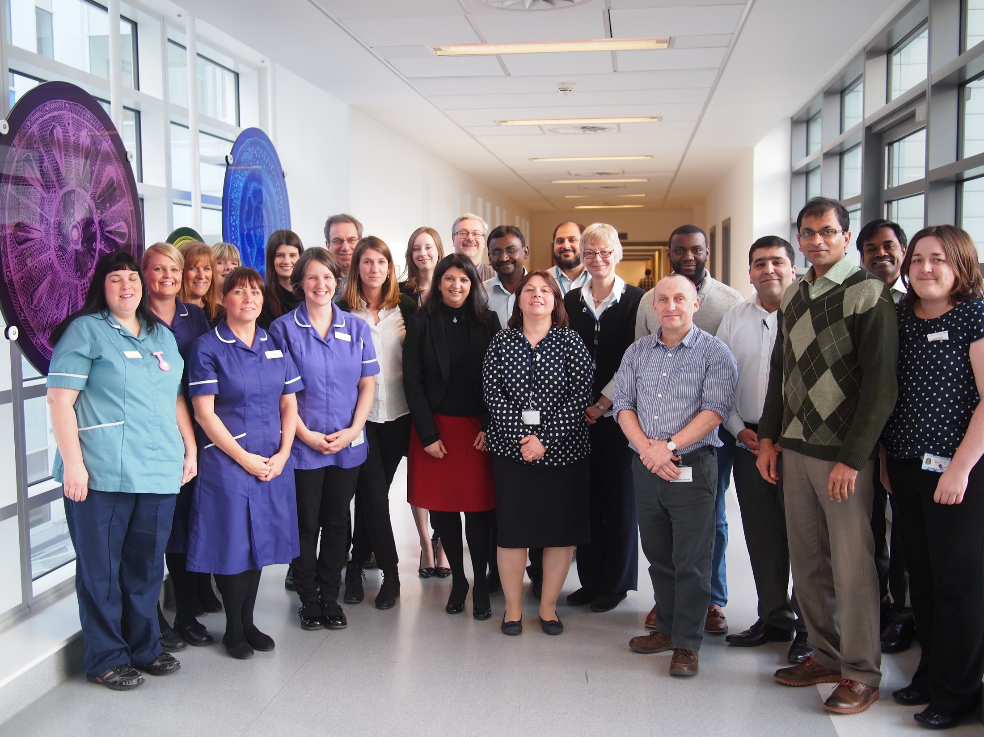




Rayne Institute
Lynn Quek
Shahram Kordasti
Alexander Smith/ Riley Cook
Joop Gaken
Jie Jiang
Azim Mohamedali
Syed Mian
Nik Lea
Steve Best
Bruno Fattizzo
Fran Smith & Nick Parkin
National PNH service
Ghulam J Mufti / Judith CW Marsh
Tony Pagliuca
Victoria Potter
Shreyans Gandhi
Pramila Krishnamurthy
Daniele Avenoso
Varun Mehra
Robin Ireland
Roochi Trikha
Sahar Mansour/Katie Snape (Clinical Geneticist)
Nurse specialists
Psychology counsellors
Notes:
50
50
Both hypoMDS and hypoAML are associated with profound pancytopenia, which may suggest a clinical diagnosis of AA. And when BM cellularity very low, it may be difficult to separate them from AA using standard morphological criteria.
Since most hypoMDS fall within RA, their blast count is not increased and may only show dyserythropoiesis, and often causes most marked overlap with AA.

Slide 51




Summary: Conceptual approach to treatment
Goals
- rapid response and avoid infections
- maintain robustness of counts
- MDS, AML, PNH, second cancers….
-fertility, QoL, psychological wellbeing
Is the diagnosis AA?
- hypocellular MDS?
If it is AA, is it acquired or constitutional?
NGS BMF panels, functional tests , genetic counselling
Constitutional AA
Assess supportive care
HLA tissue type
Biobank: PB, BM, skin
Acquired AA
Age, comorbidities
Disease severity
Donor availability
Danazol
HSCT
Children ✓
Adults ( ✓ )
ATG/CSA/EPAG
MSD HSCT
MUD HSCT
Eltrombopag
Relapse prevention & avoidance of graft failure
Novel therapies
Ex vivo expanded autologous Tregs
IL2RG subunit gamma monoclonal ab
Romiplostim
Refractory AA (failed ATG/CSA/EPAG)
Haploidentical/
Cord blood HSCT
2nd ATG
Campath/Danazol/
Sirolimus
Notes:
Recently, FDA granted breakthrough therapy designation to eltrombopag
for use in combination with IST for the treatment of SAA as a first-line therapy.

